Slide 1

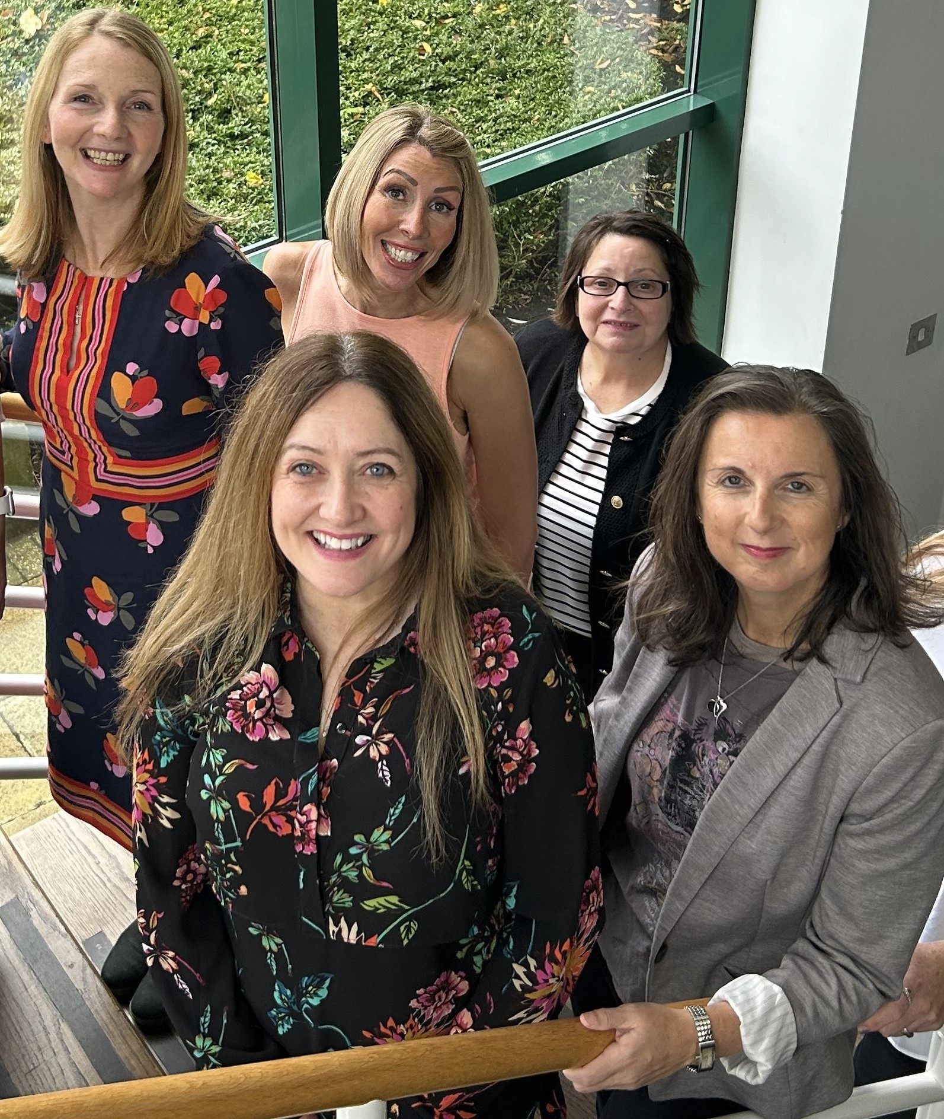
Annual Event 2024/25
Natasha Douglas
Healthwatch Stockton-on-Tees
Manager

Slide 2
Overview of the Day
Welcome
Housekeeping
Aims of the day
Our Year 2024 – 2025
Hear from guest speakers: raising awareness and building strong networks
Support the development of the Healthwatch Stockton-on-Tees workplan 2025 - 2026

Slide 3
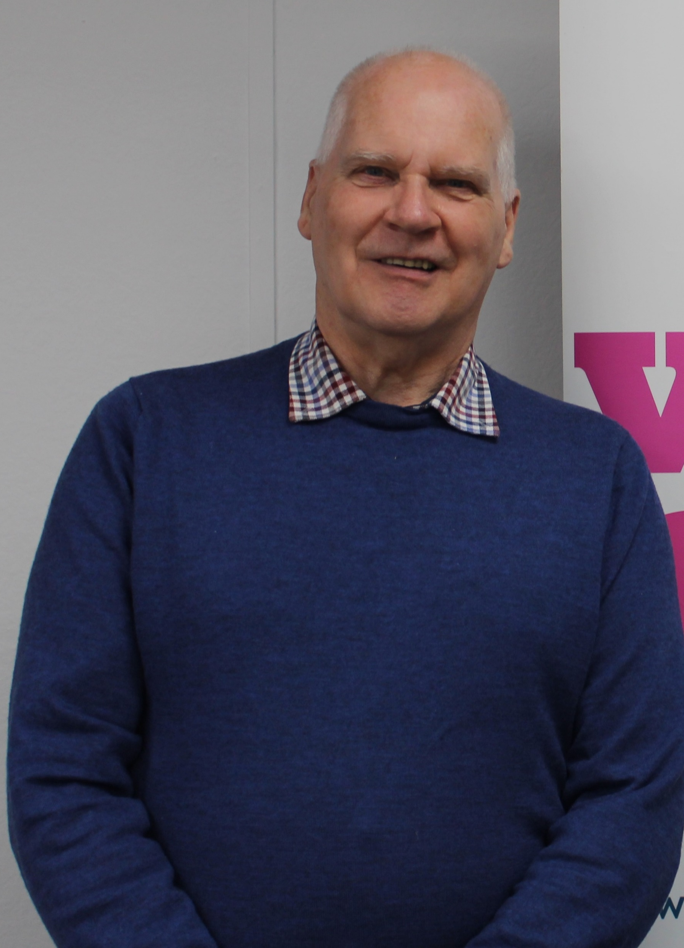
Peter Smith: Chair
Healthwatch Stockton-on-Tees
Overview of the Year

Slide 4

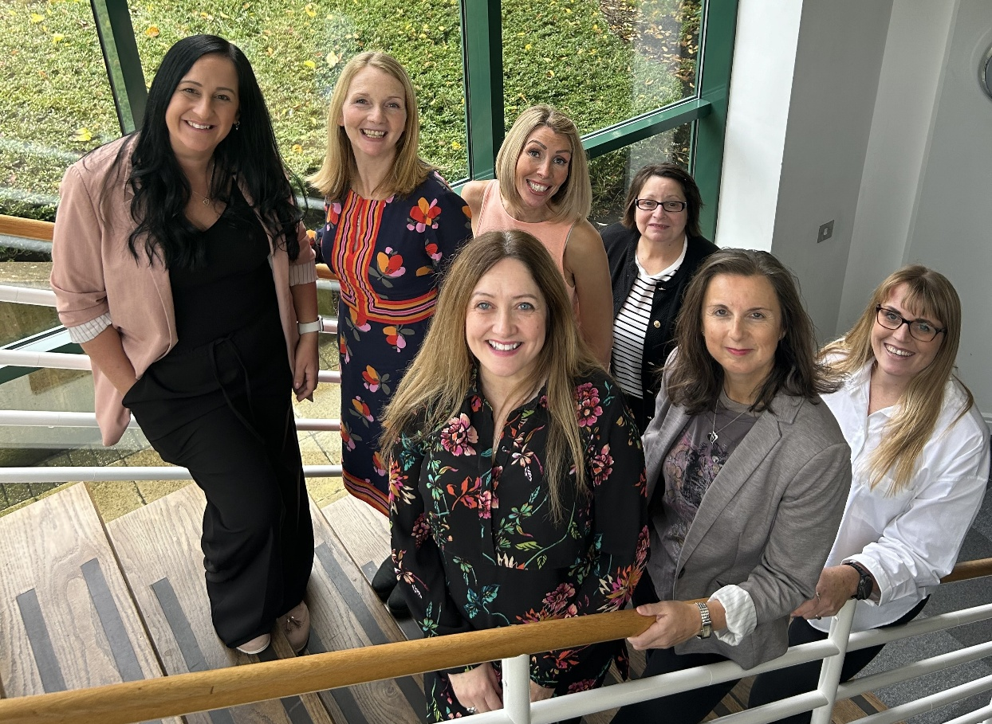
Mobilisation Phase
Transition into People First
New offices secured
New reporting styles & cycles – Staffing restructure
Internal training and inductions nearing completion
Initial meetings and reassurance provided to commissioners
Healthwatch Stockton-on-Tees (HWS) Board meetings taking place on quarterly basis

Slide 5
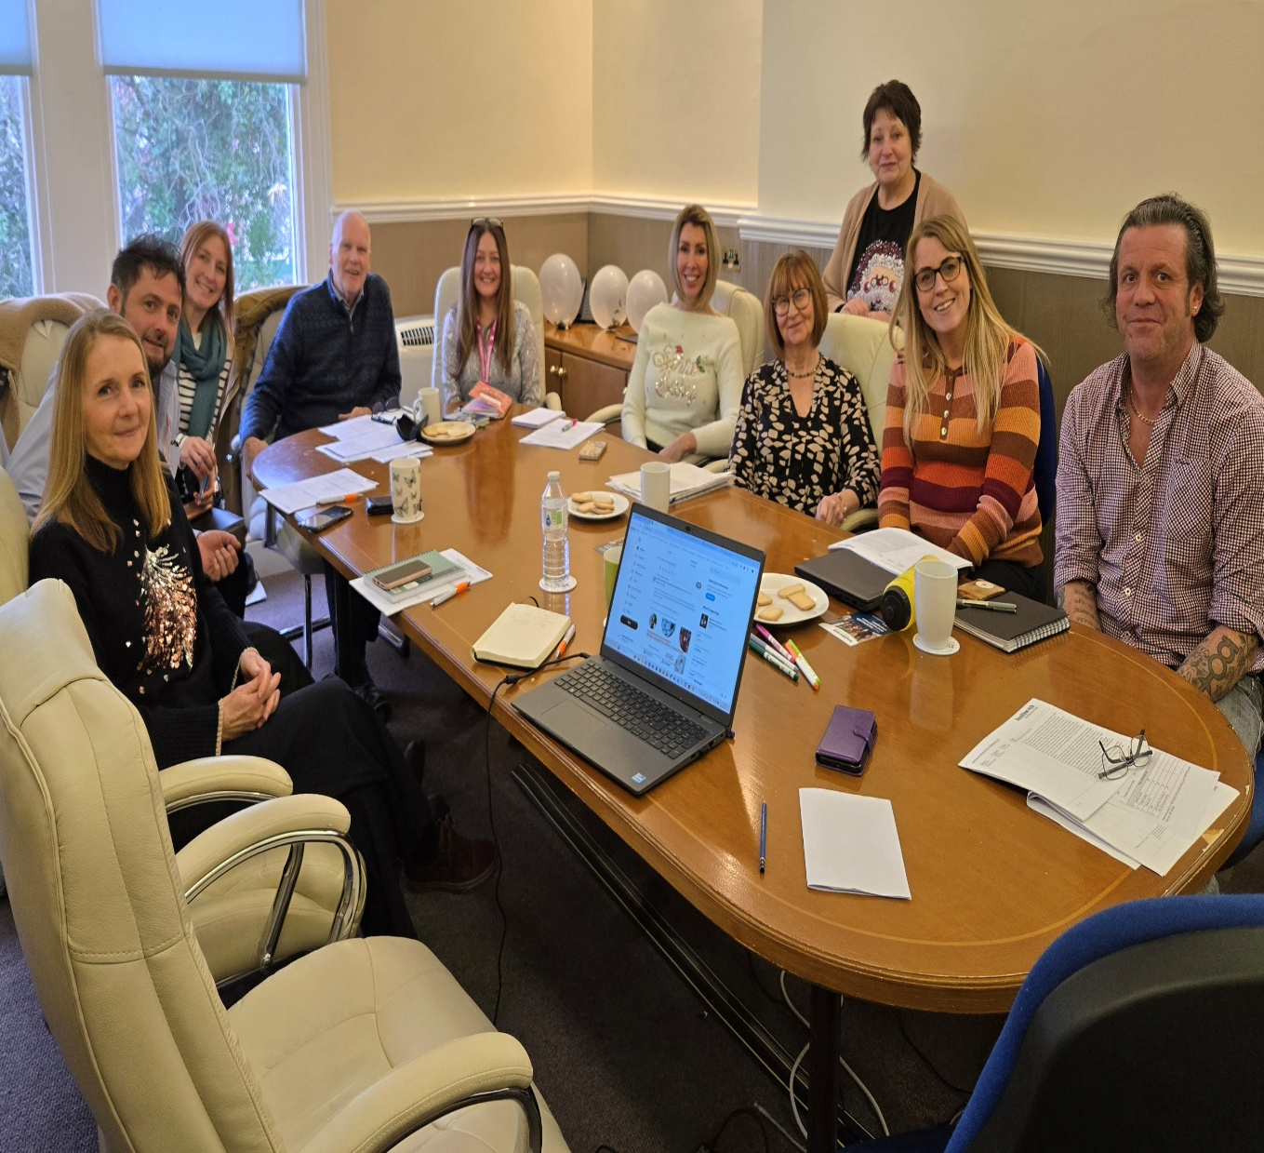
Healthwatch Stockton-on-Tees Model
Independent Board of Volunteers
Responsibility and oversight of workplan priorities
Clear and transparent decision-making processes
Providing added value to the delivery of
HWS
Notes:
Range of knowledge / interests covering health & social care

Slide 6
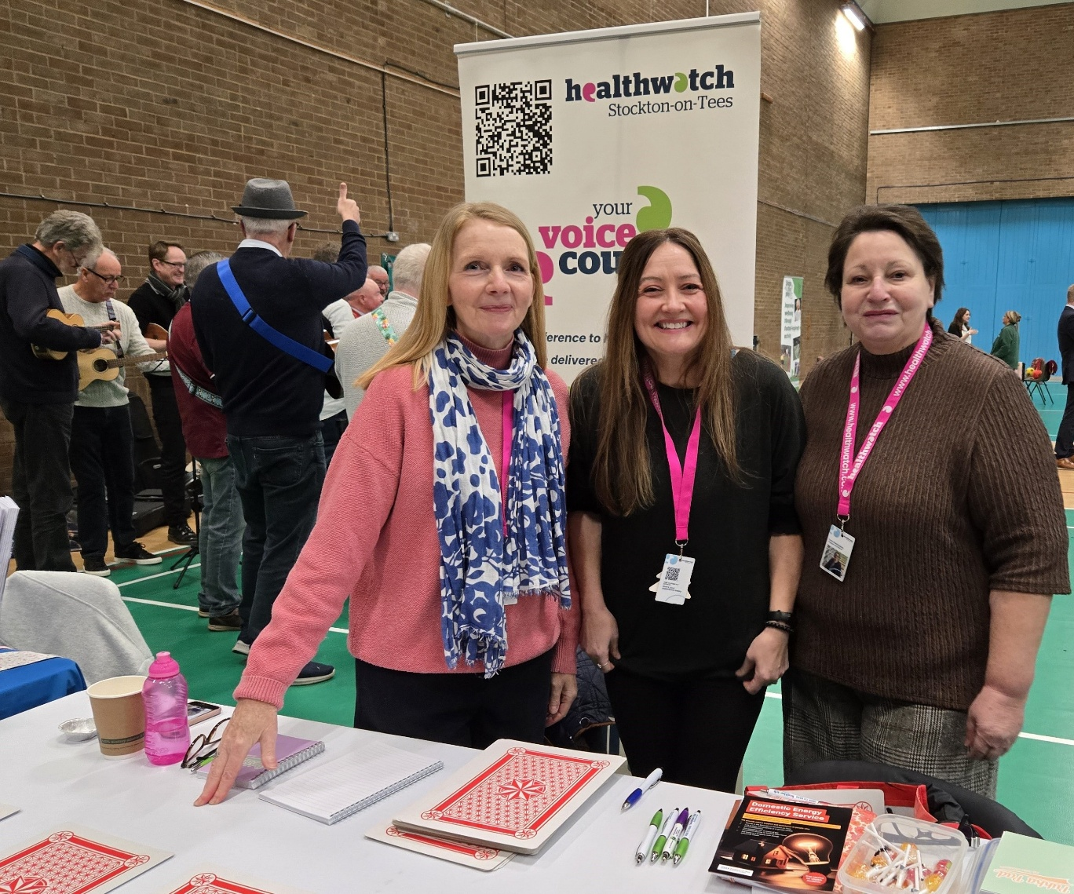
Healthwatch Stockton-on-Tees Model (cont…)
19 Volunteers
30 Health & Care Ambassadors
Healthwatch Champions
4 members of staff – 2 full-time & 2 part-time

Slide 7
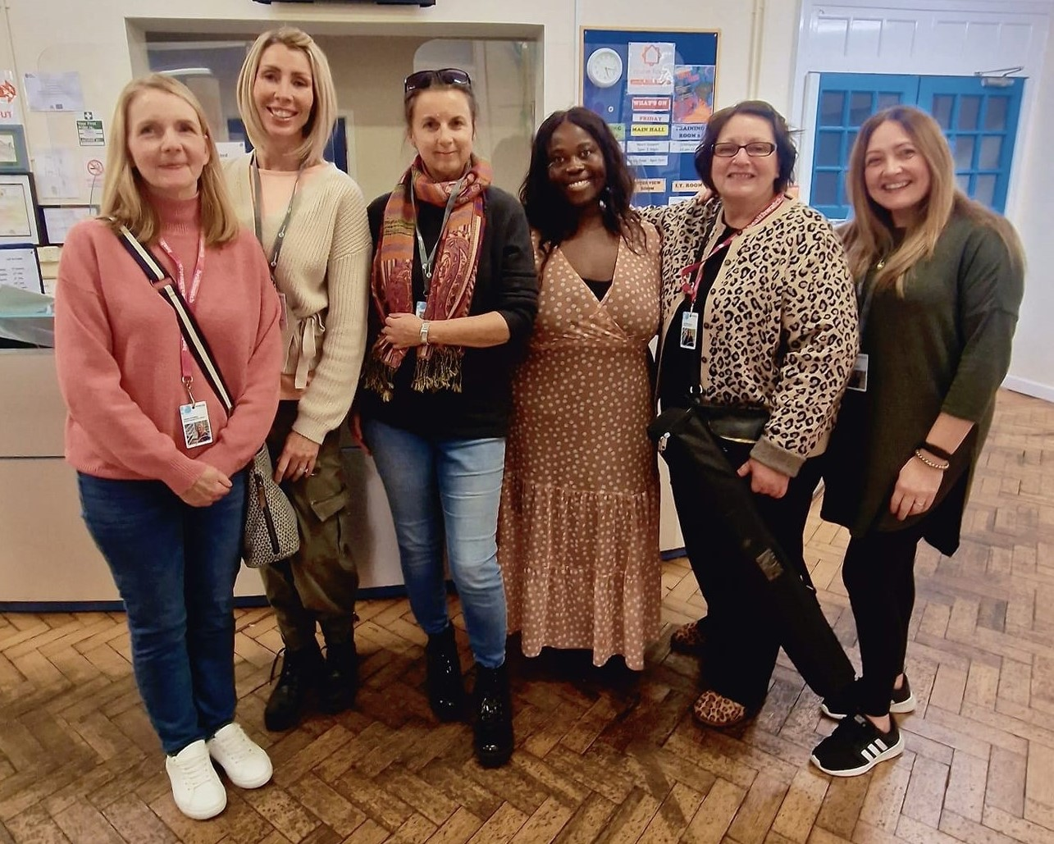
Workplan 2024/25
Migrant Health
Young People
Health & Care Ambassador Programme
NENC ICB Consultation
    Women’s Health
    Dentistry
    NEAS
    NHS 10 Year Strategy

Slide 8
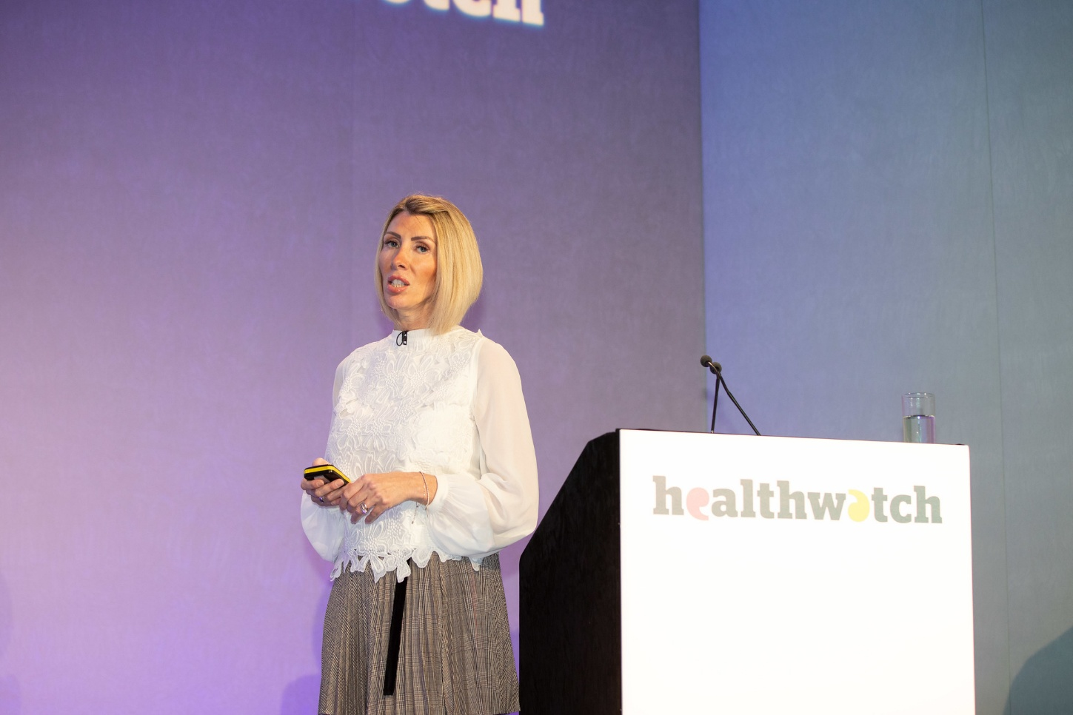
Highlights
Continued engagement during the transition period, including workplan item focus
Healthwatch England Conference – raising the voices of people accessing ADHD & Autism services
Awareness video launch – Larissa Bennett

Slide 9
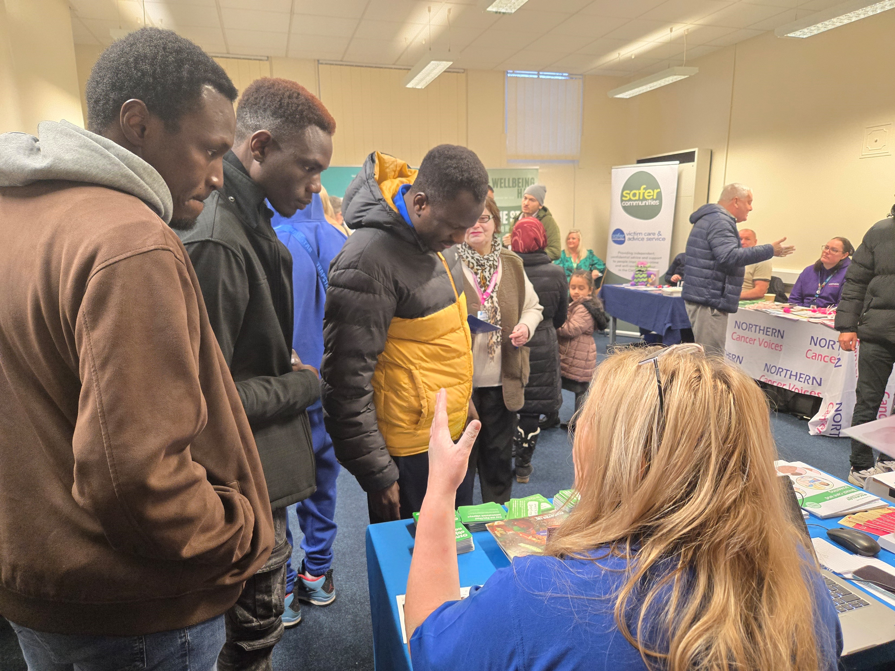
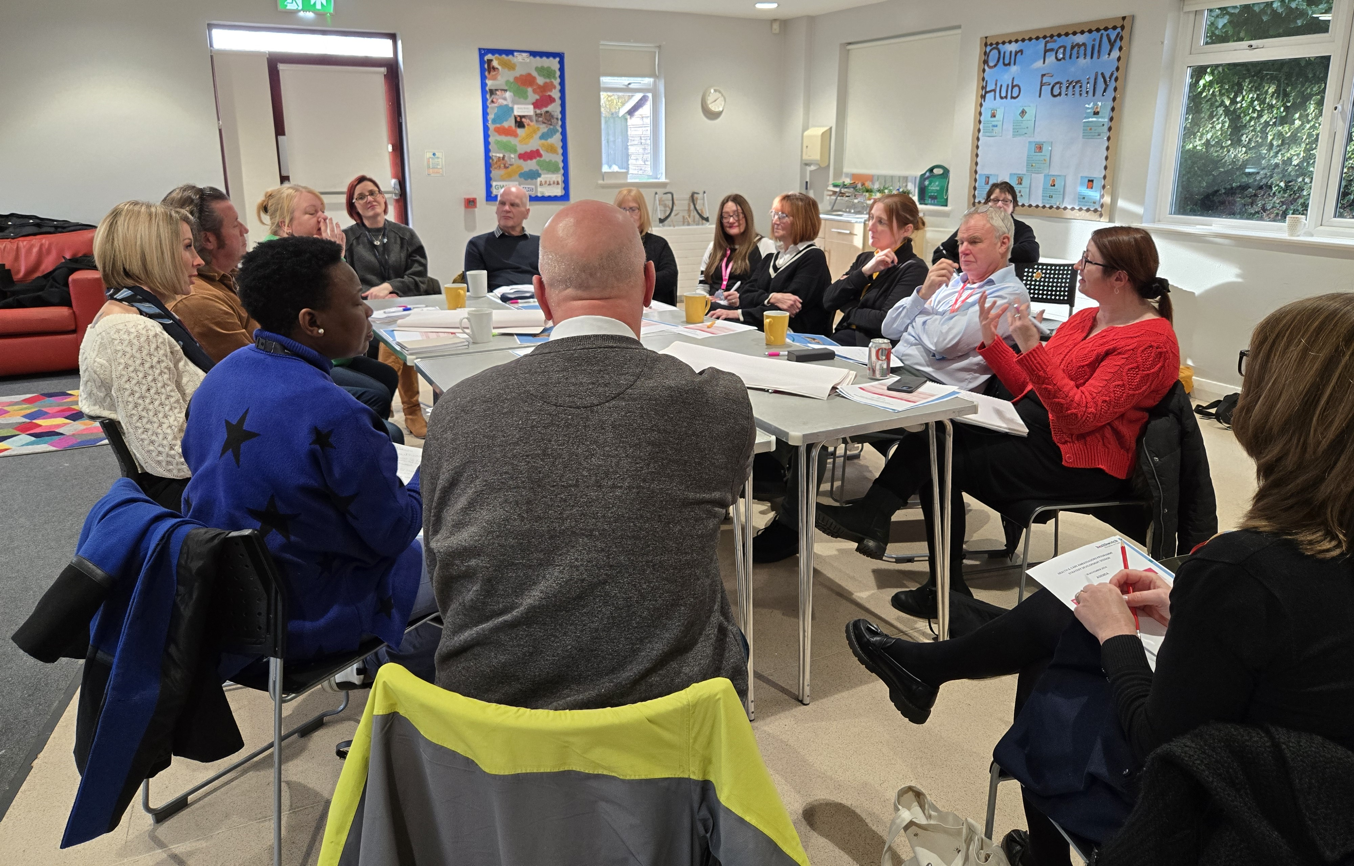
Highlights (cont…)
Health & Care Ambassador Events – taking services to the heart of disadvantaged communities
Developing the network of Ambassadors
Senior Leaders Planning Session – building capacity in the system, strengthening working practices

Slide 10
Outcomes
ADHD
Drug & Alcohol
Migrant Health
Women’s Health
Young People
Notes:
ADHD - National recognition, ongoing priority for change – Peer Support Group Launch.
Drugs & Alcohol - The Healthwatch Report is in use for the ongoing Health Needs Assessment, Service Review and Service Model Development.
Details of things implemented or planned following the report include:
CGL have implemented a freephone telephone number
We have plans in place to expand out-of-hours support
Bridges will be co-locating a day a week with CGL very soon, and attending CGL’s full team meeting this week to promote what support they can offer to families and carers – so joint working has and will continue to improve.
A dedicated marketing and comms lead is helping to raise awareness of the service and share key messages, information, and resources around harm reduction etc.
CGL have organised an Open Day event on Tues 8th April which will be open to partners, families/carers and service users – to let them have a tour of the building/service, learn about what is offered, and take part in some taster sessions.
Migrant Health
Development of Health and Care Ambassador Programme- bringing health and care services to communities using a planned approach to tackle specific emerging issues based on real time intelligence.
To date this includes:
Women’s Health - Menopause Café, working in collaboration with HASH to take it to the migrant community, along with screening services. Access to Primary Care – including Blood Pressure checks, screening, sexual health and other wellbeing services.
Young People – event to support raising awareness and providing volunteer opportunities for young people – Next event planned to support the role out of additional training for professionals re drug & alcohol, awareness raising and relationship building. Healthwatch Stockton-on-Tees currently sitting on the Young Peoples Forum to support with ongoing development.

Slide 11
Priority Areas
Continued review of governance and data collection, including Social Value, to ensure robust reporting practices that align to People First outcomes and objectives
Developing new working practices with People First Advocacy – to strengthen voices and influence
Development of volunteer and engagement strategy, harnessing best practice and learning with colleagues from People First
Health & Care Ambassador Event focused on Young People

Slide 12
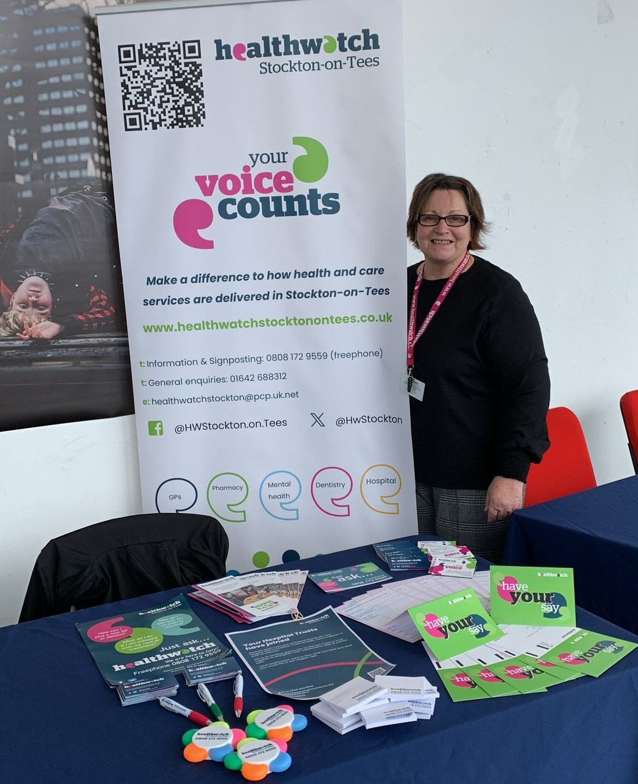
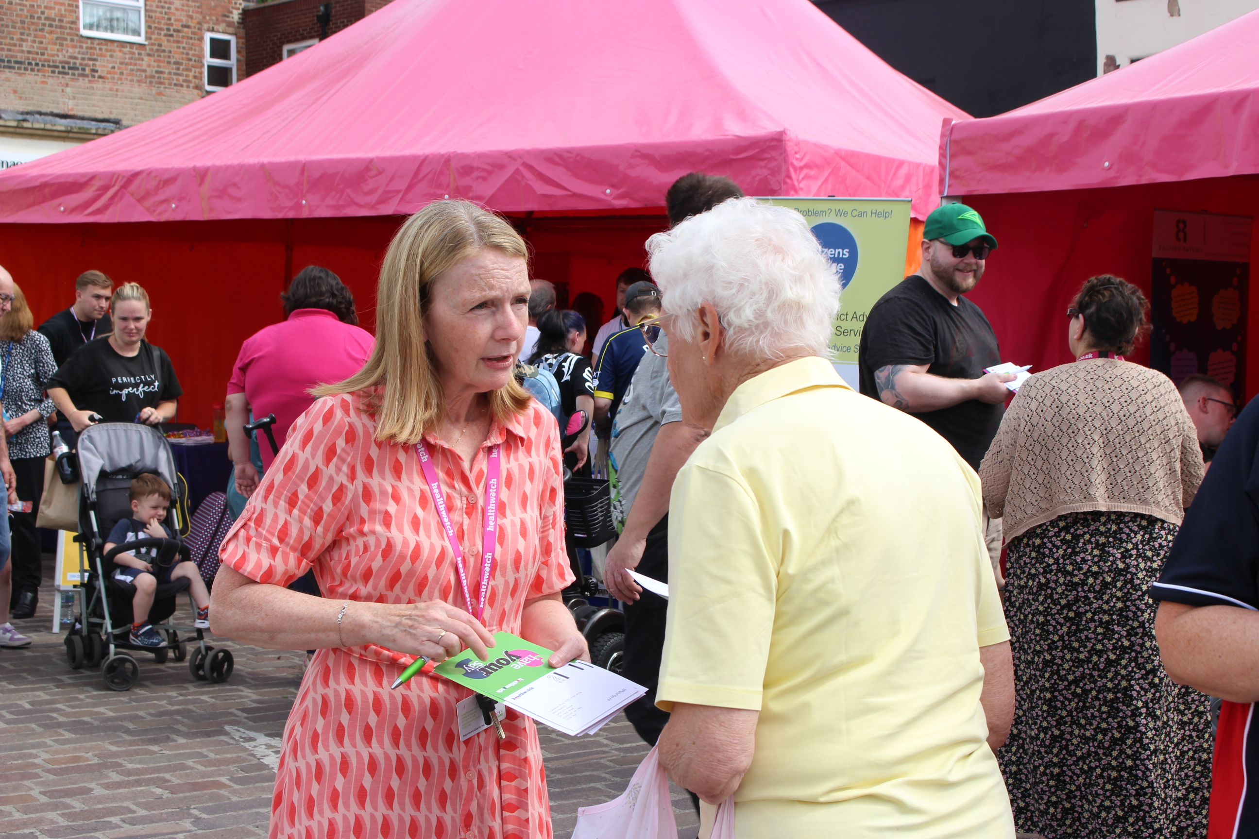
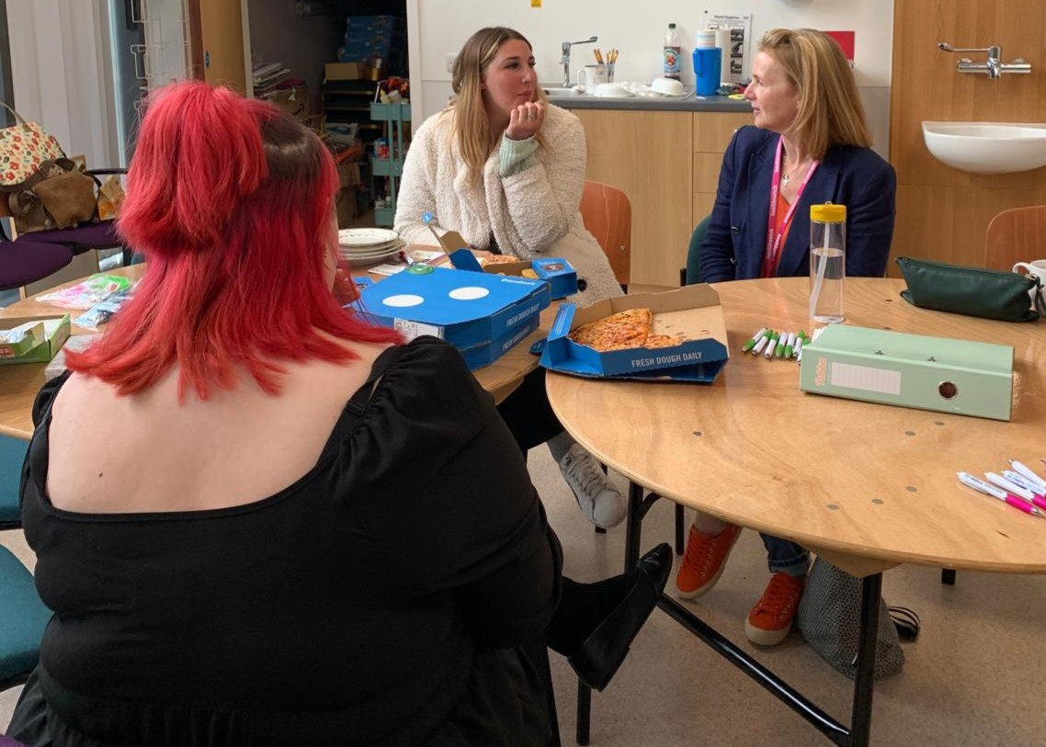
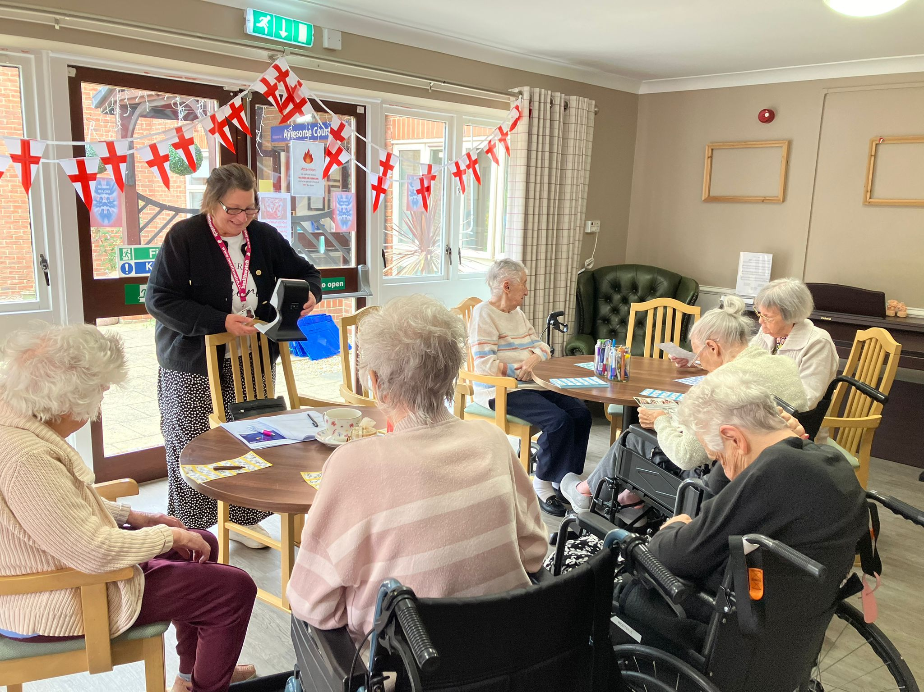
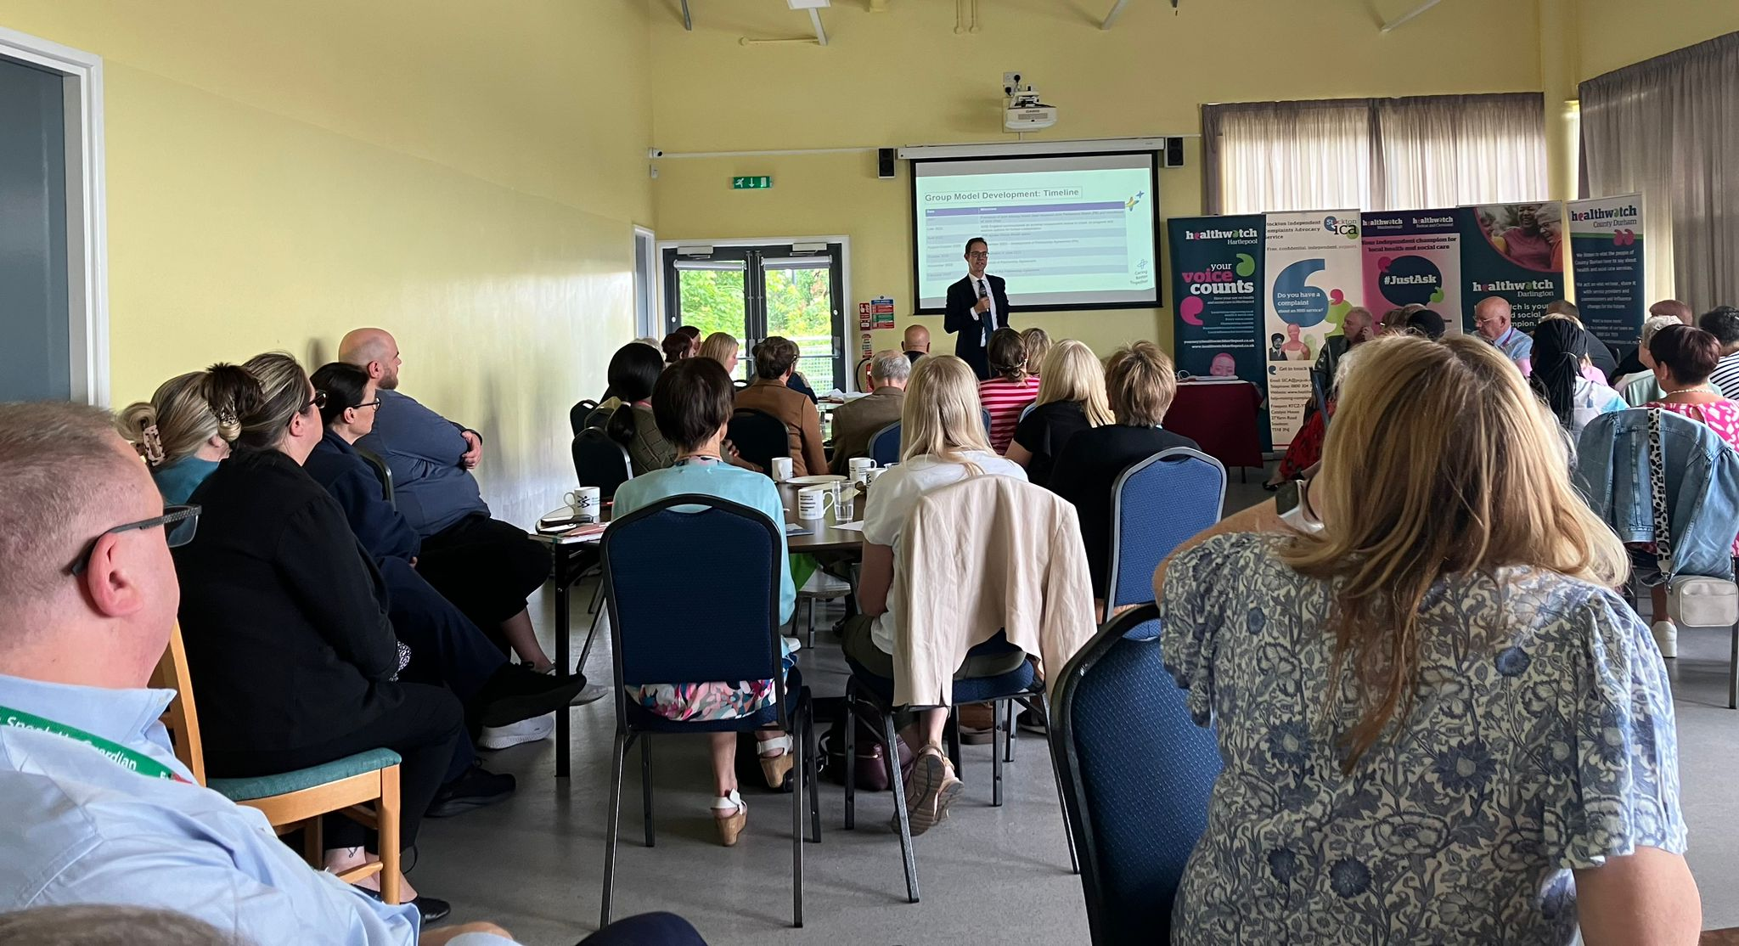
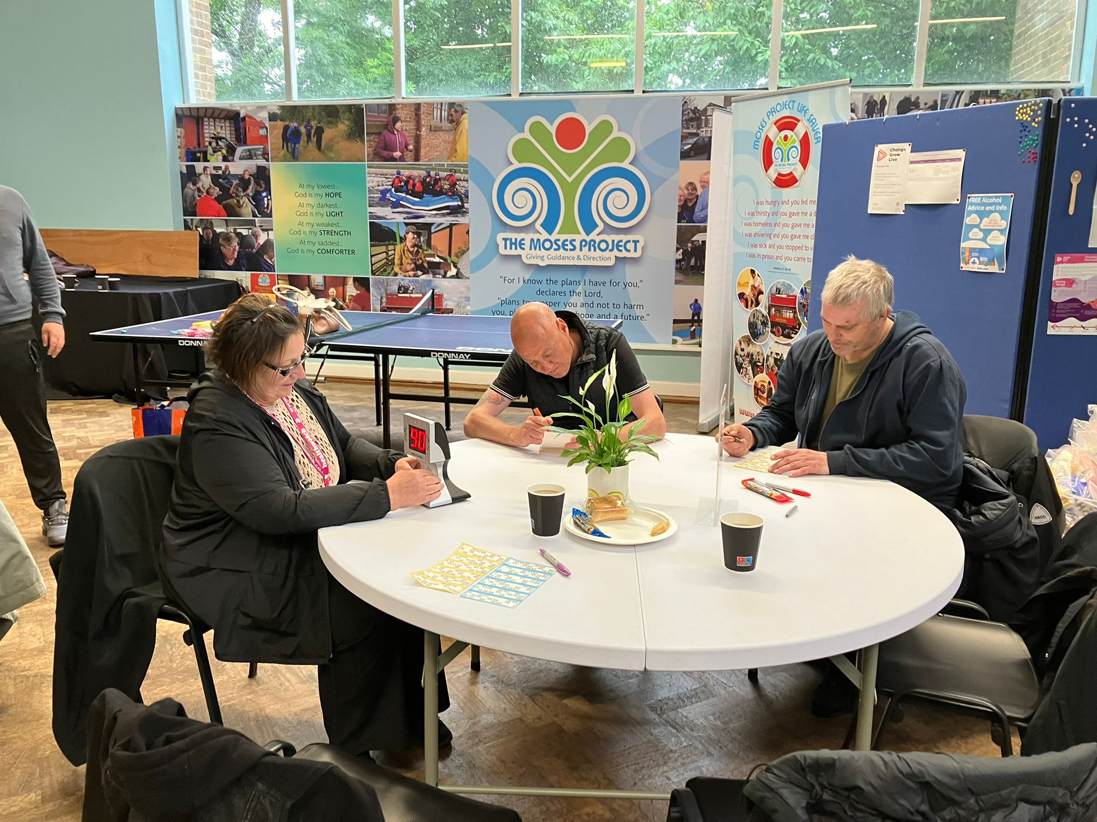
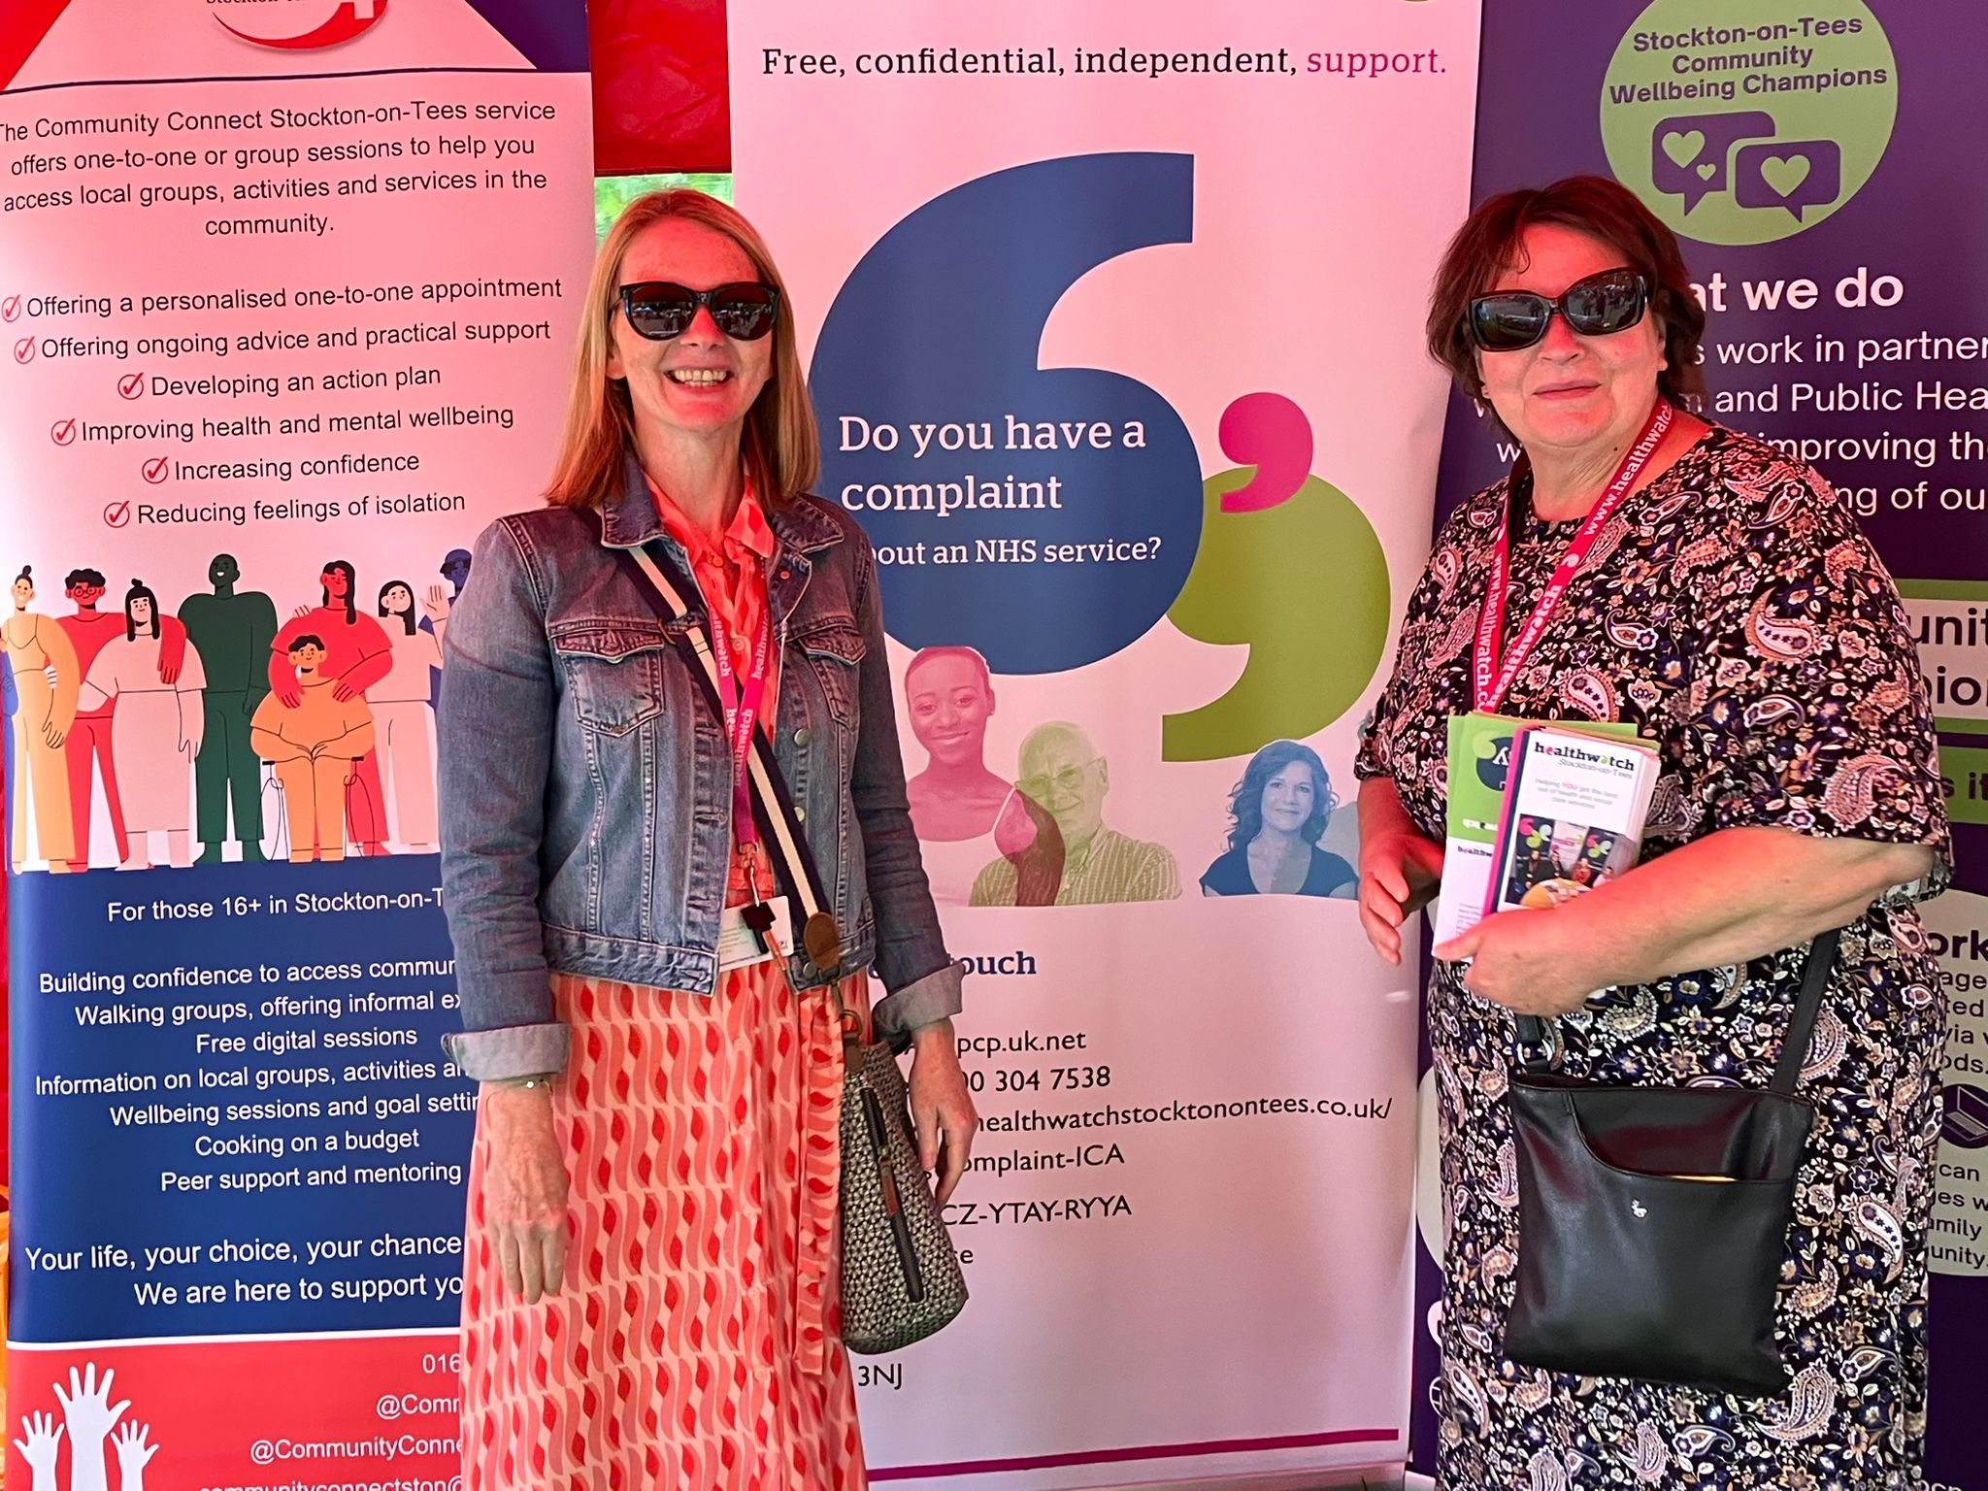
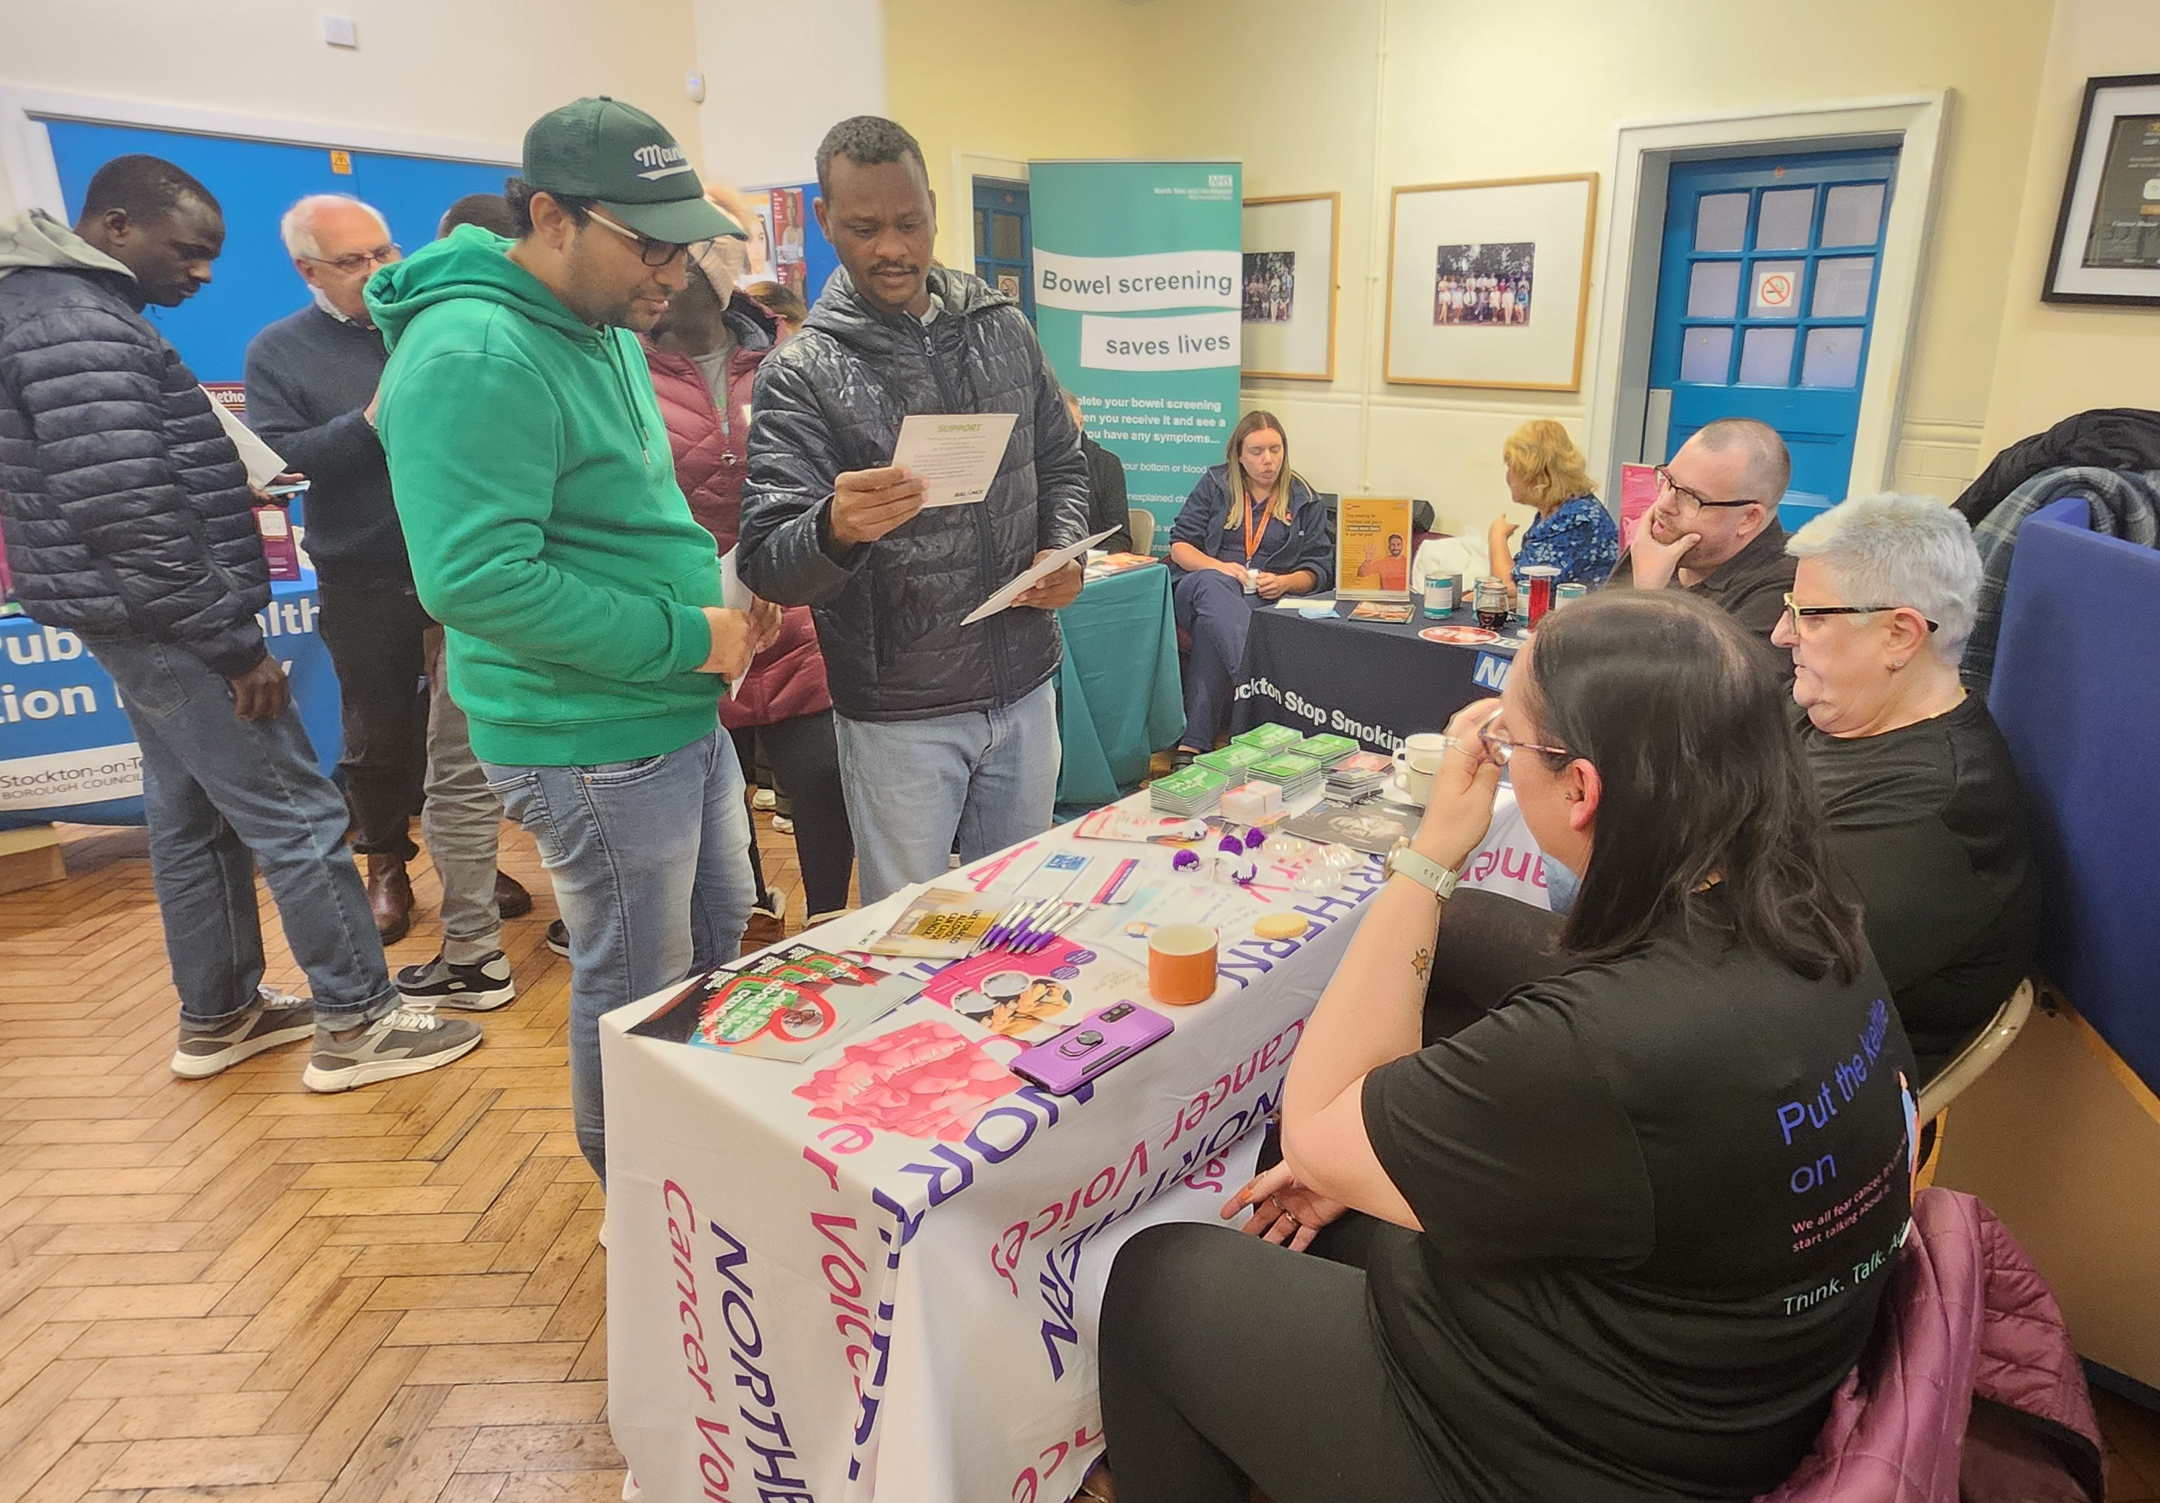
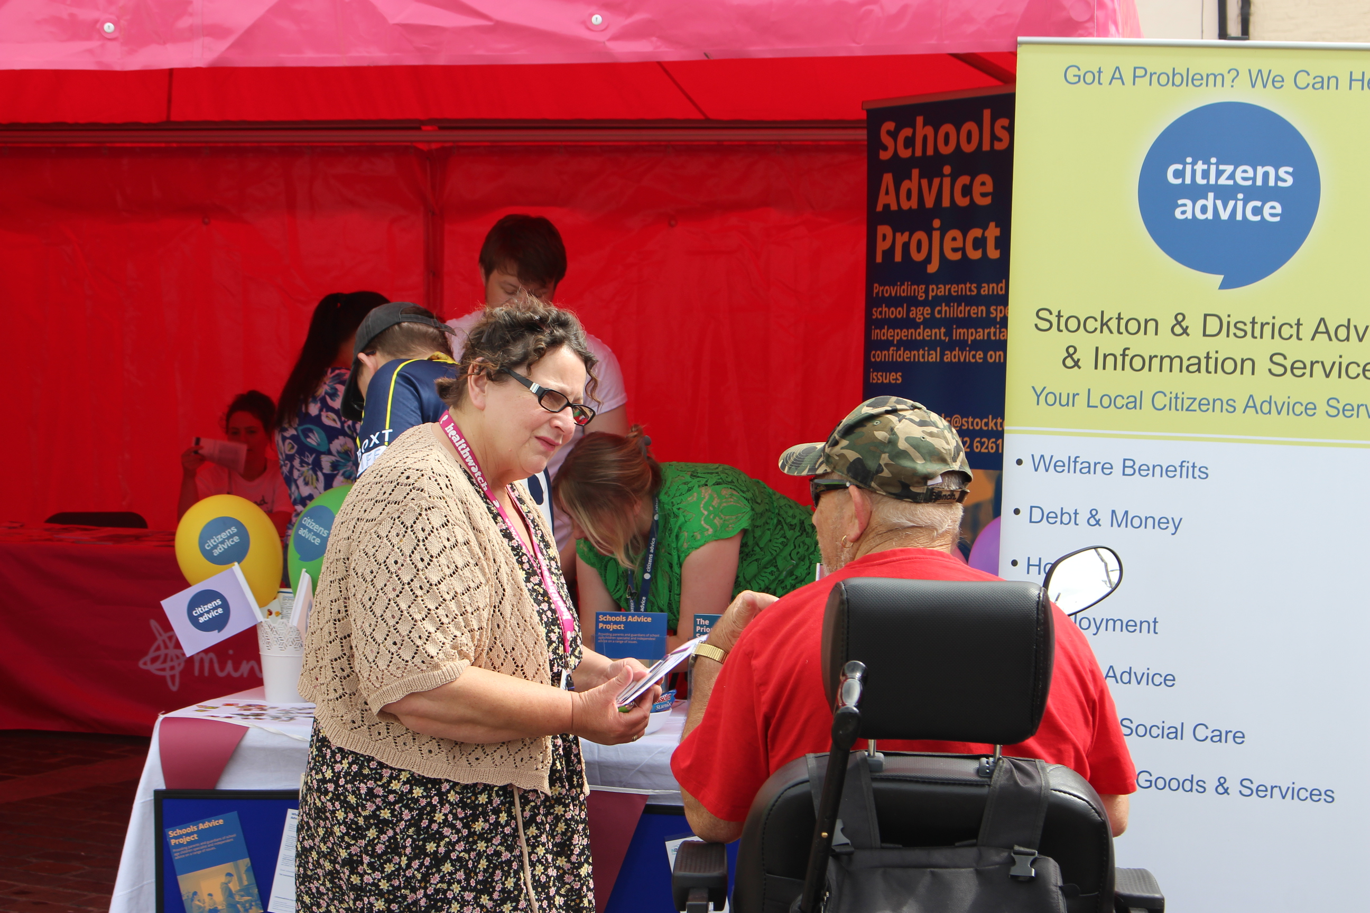
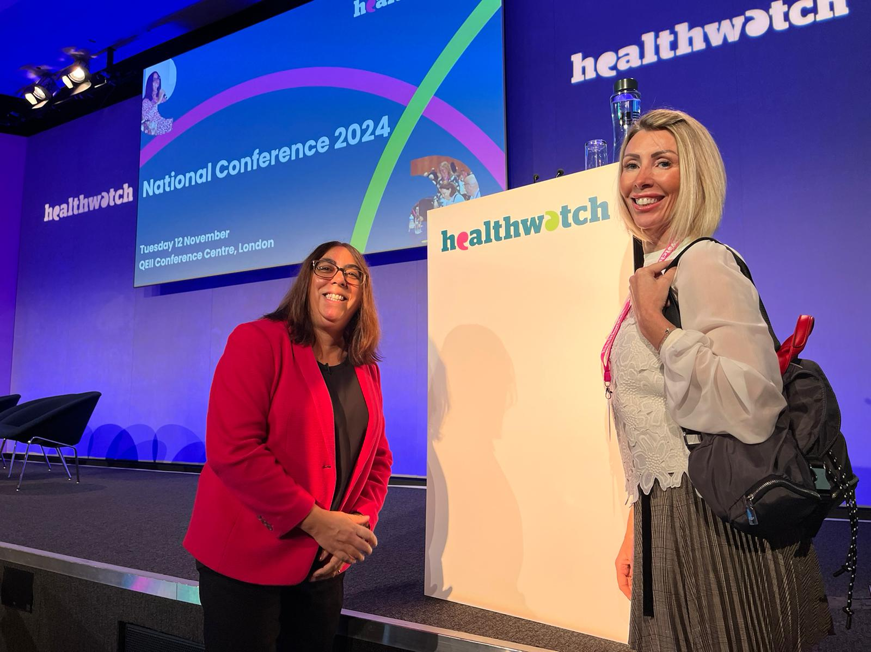
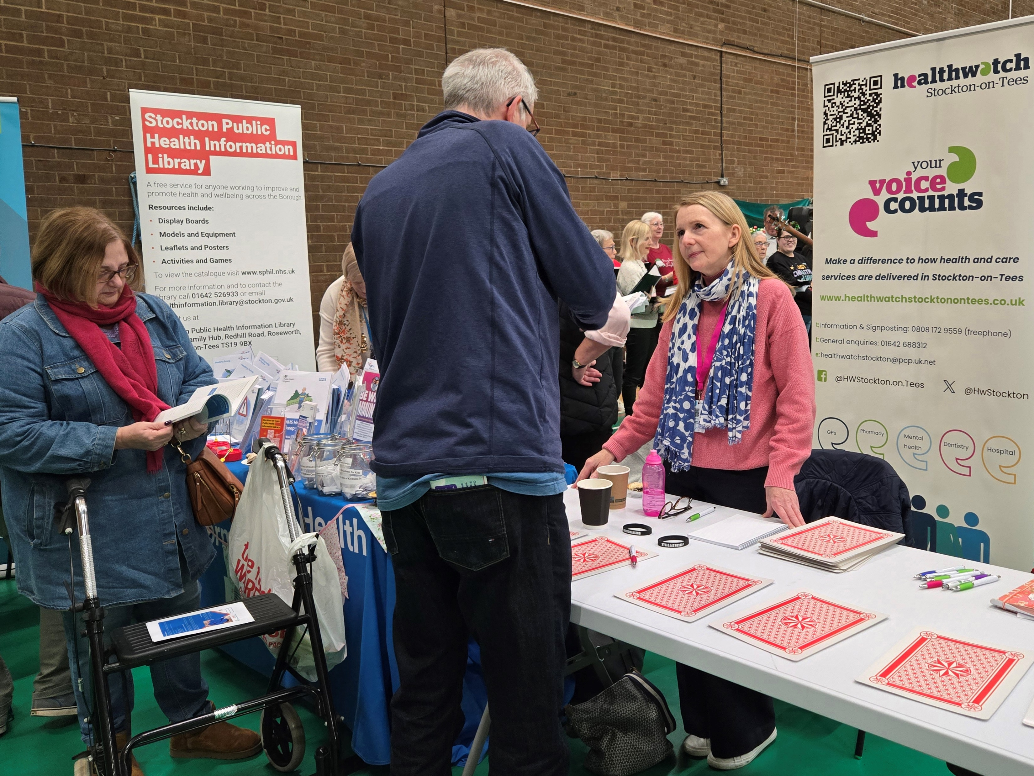
Thank you

