Slide 1


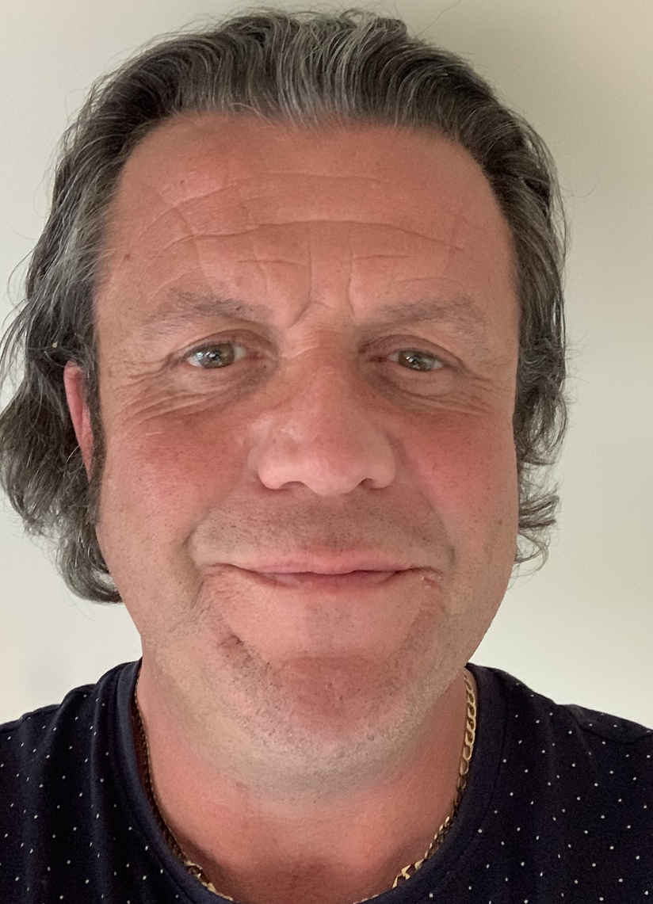
Liam Knowles: Family Support Worker
Bridges Family & Carer Service
Drug & Alcohol Awareness

Slide 2
Addiction Training

Slide 3
Who can be impacted by addiction?
Any age
Any Culture
Any socioeconomic group
Any religion
Any ethnicity
Any level of education
Working/ Not Working
Me
You
Risk Factors:
We all have them

Slide 4
Liam Knowles
Talk about yourself for a few minutes Liam, they will love it
Why I do this? What is this?
Free training to anyone who will help me with Power Point

Slide 5
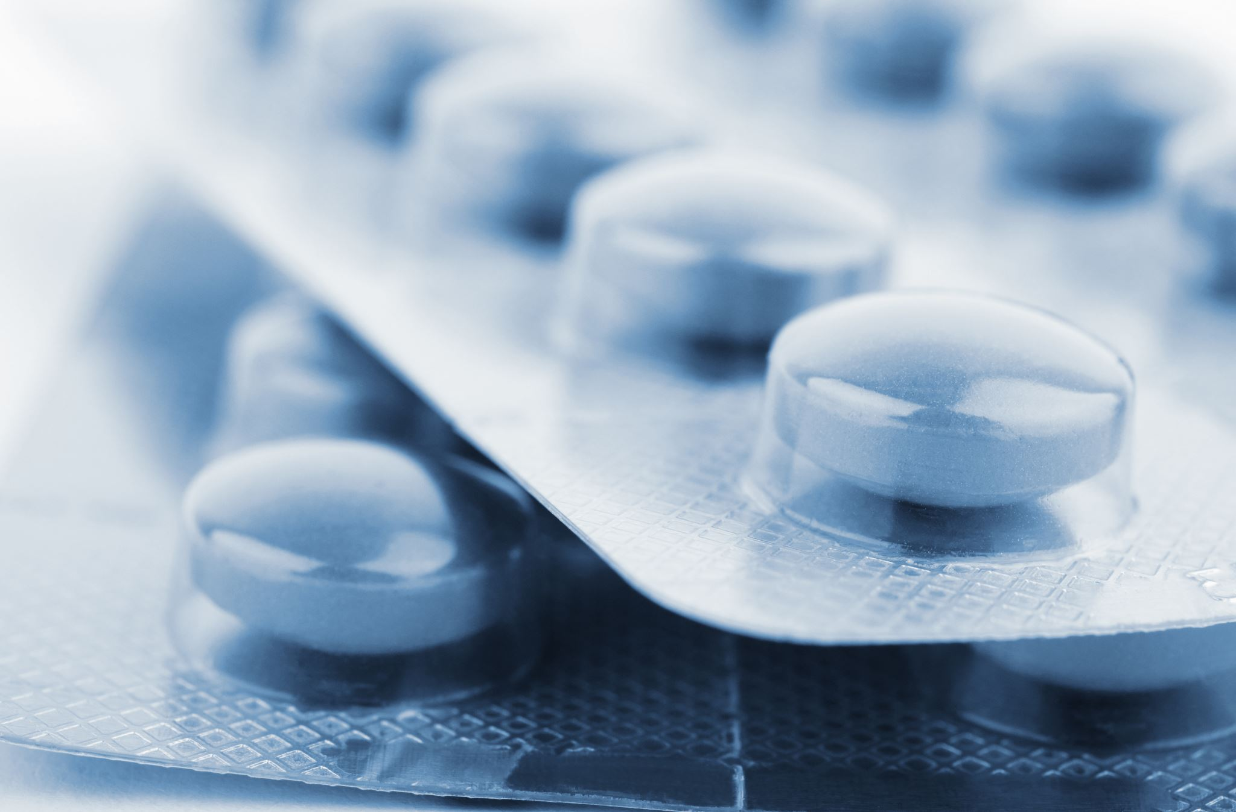
Addiction
‘it’s all in their head’
Obviously

Slide 6
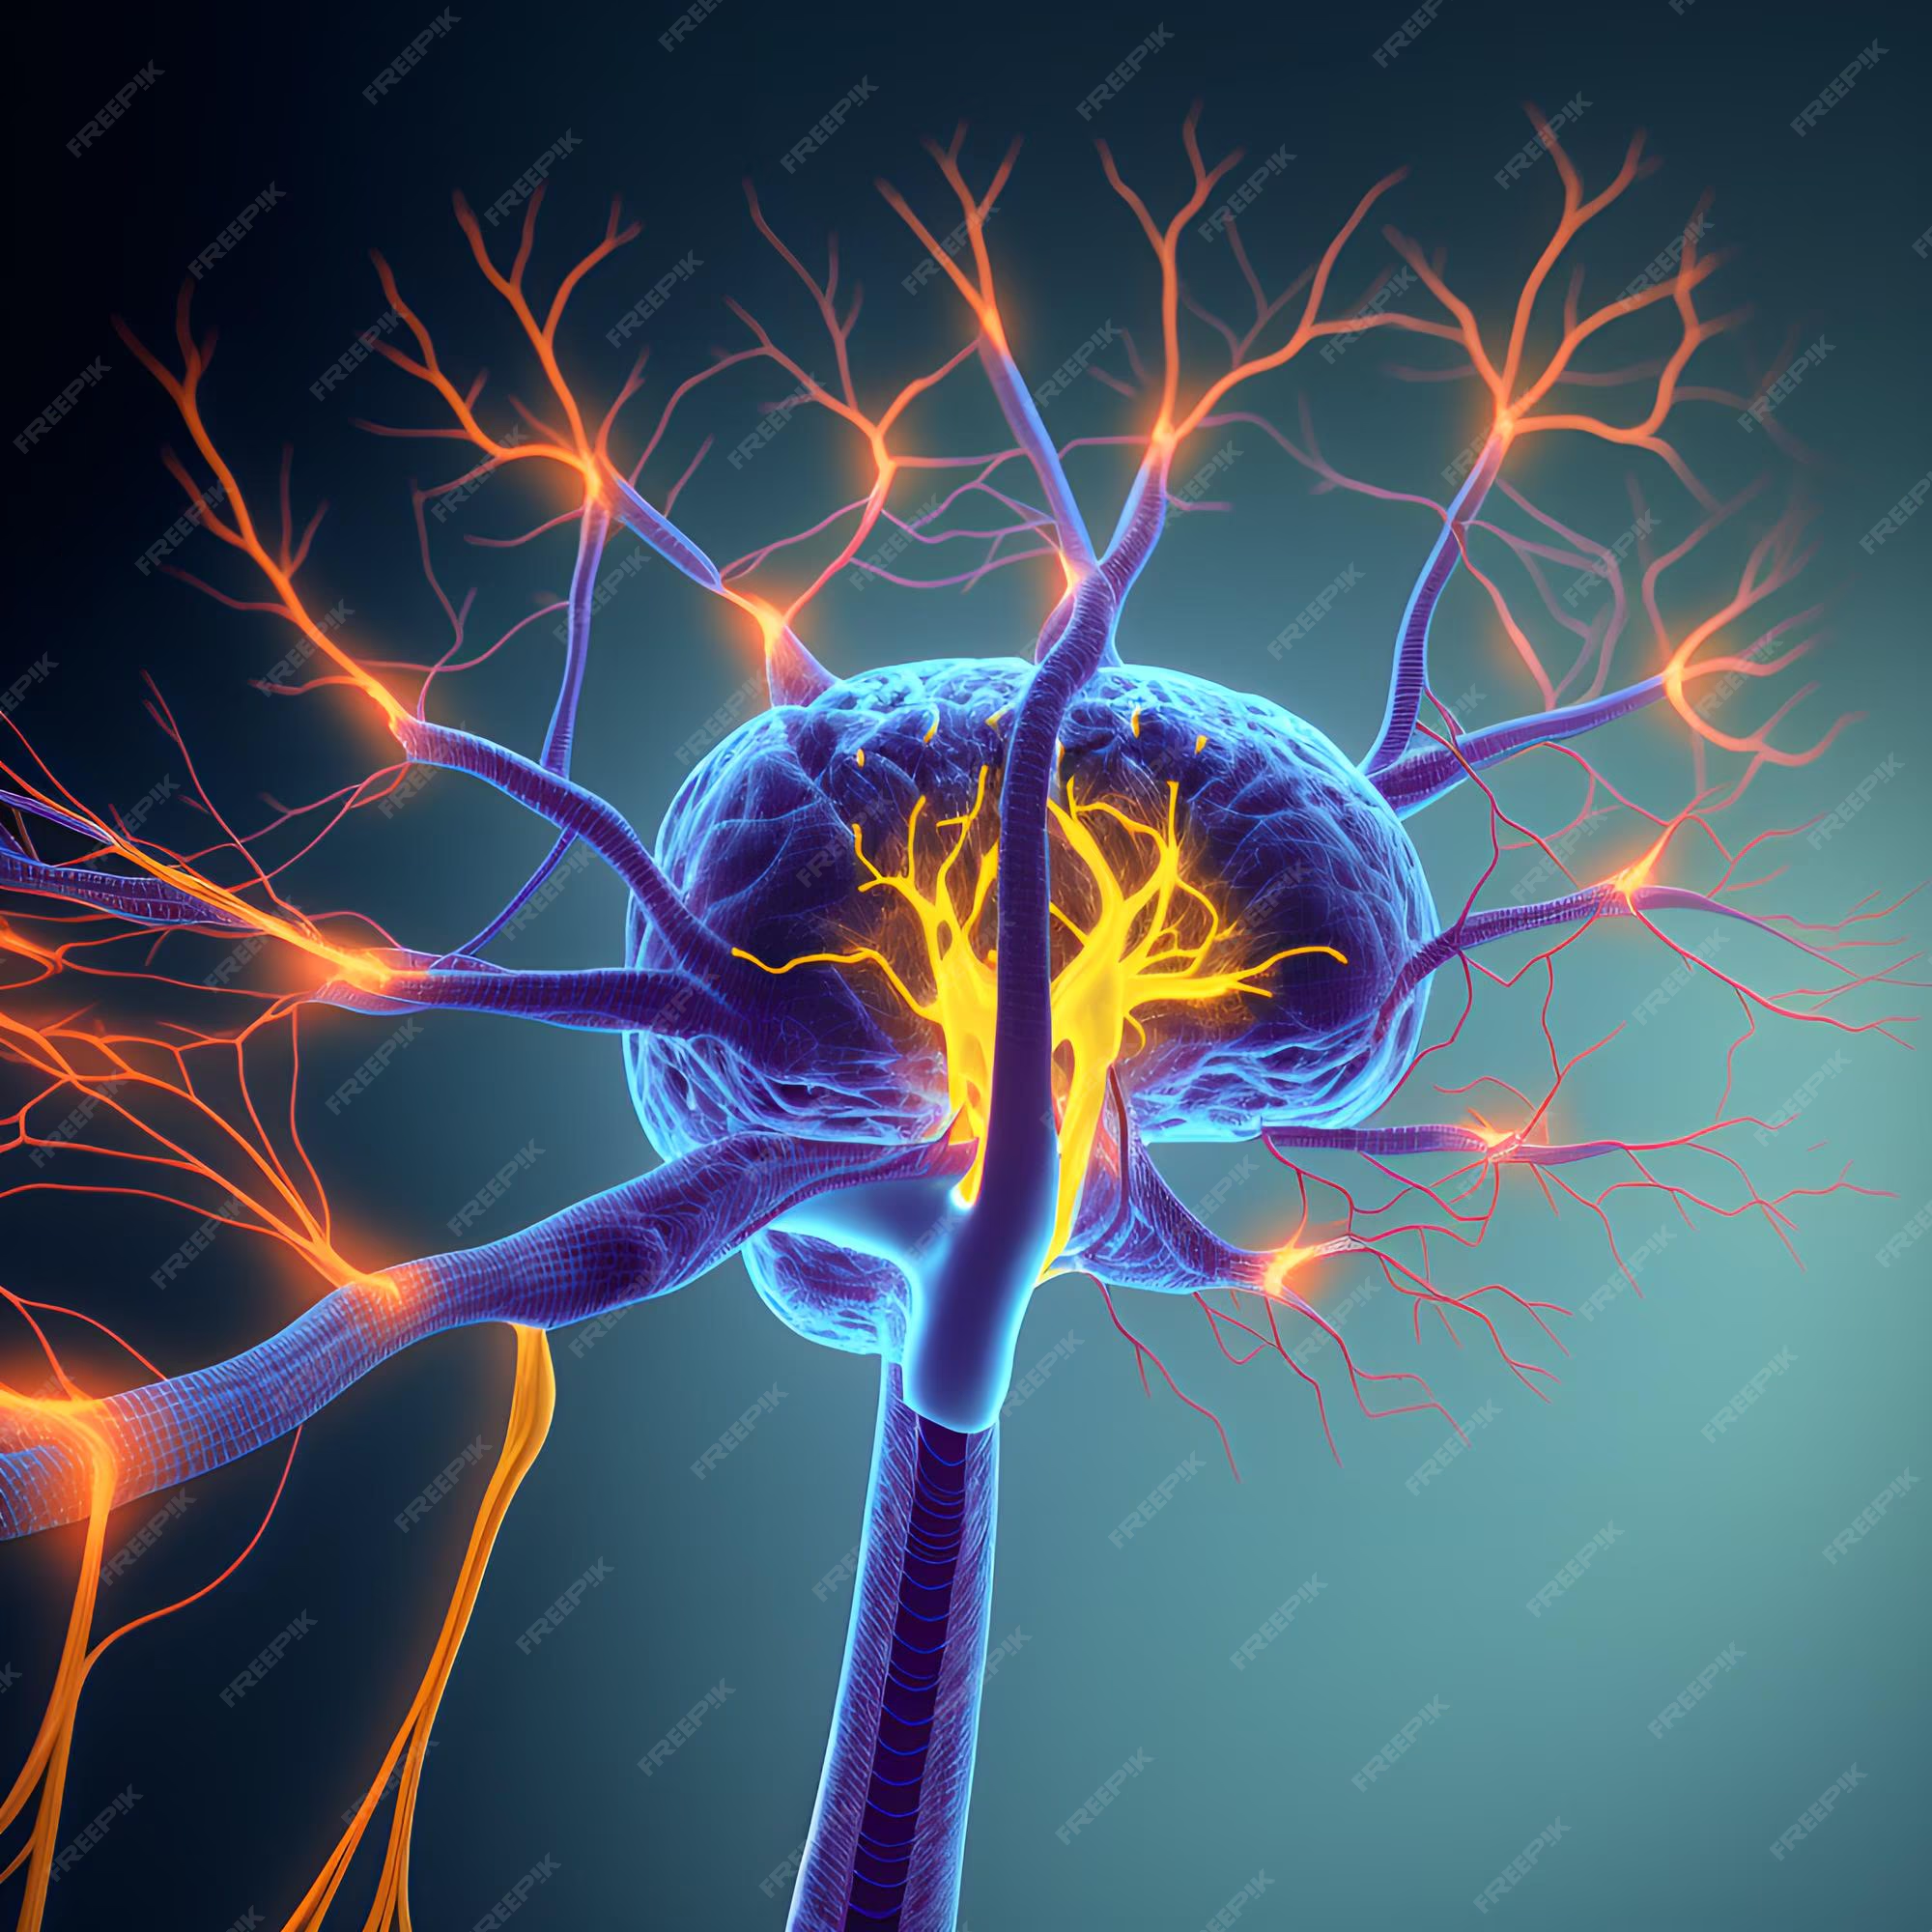
Neuroplasticity
Pathways in the brain
Learning something new
Let’s try crossing our arms

Slide 7
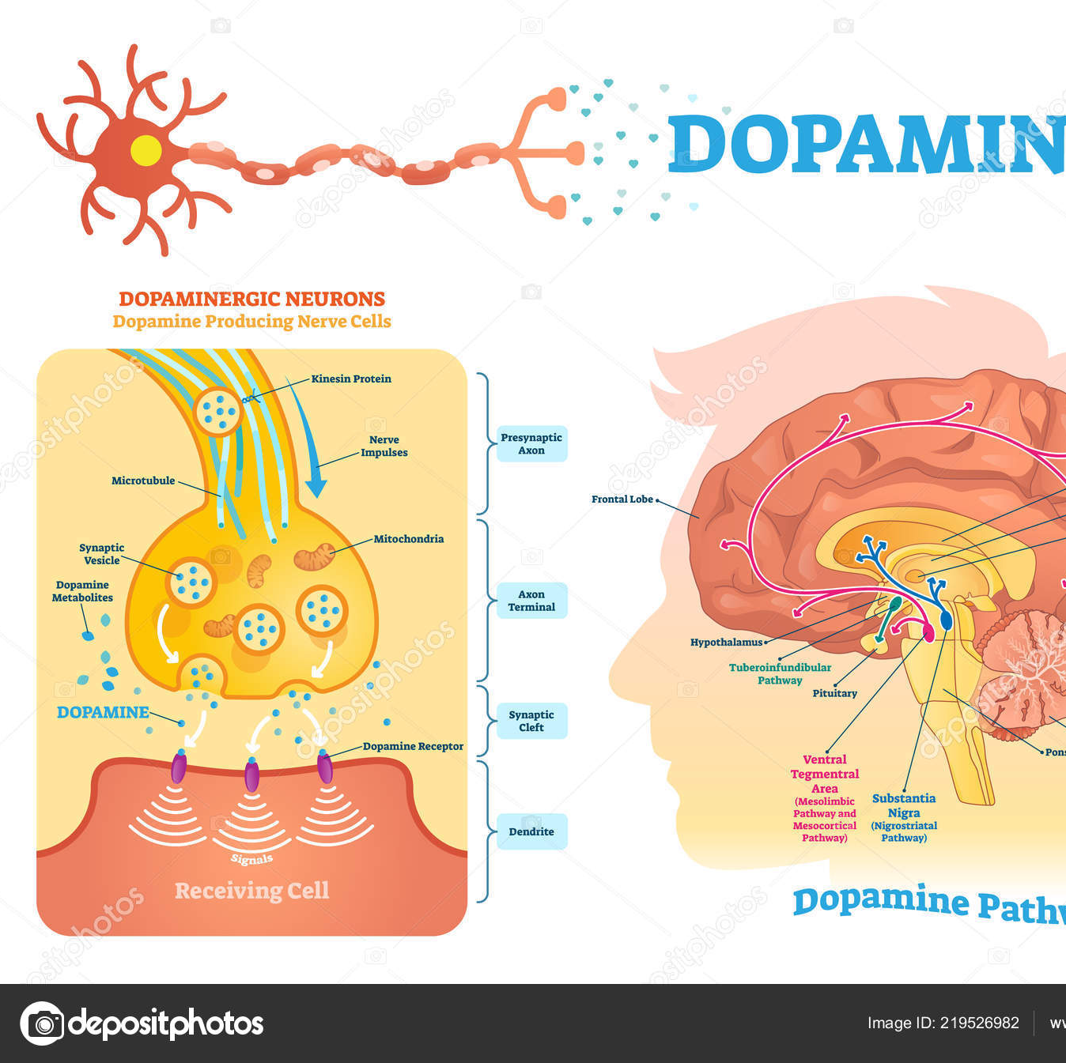
Neurotransmitters
Dopamine
What is it?
What is it for?

Slide 8
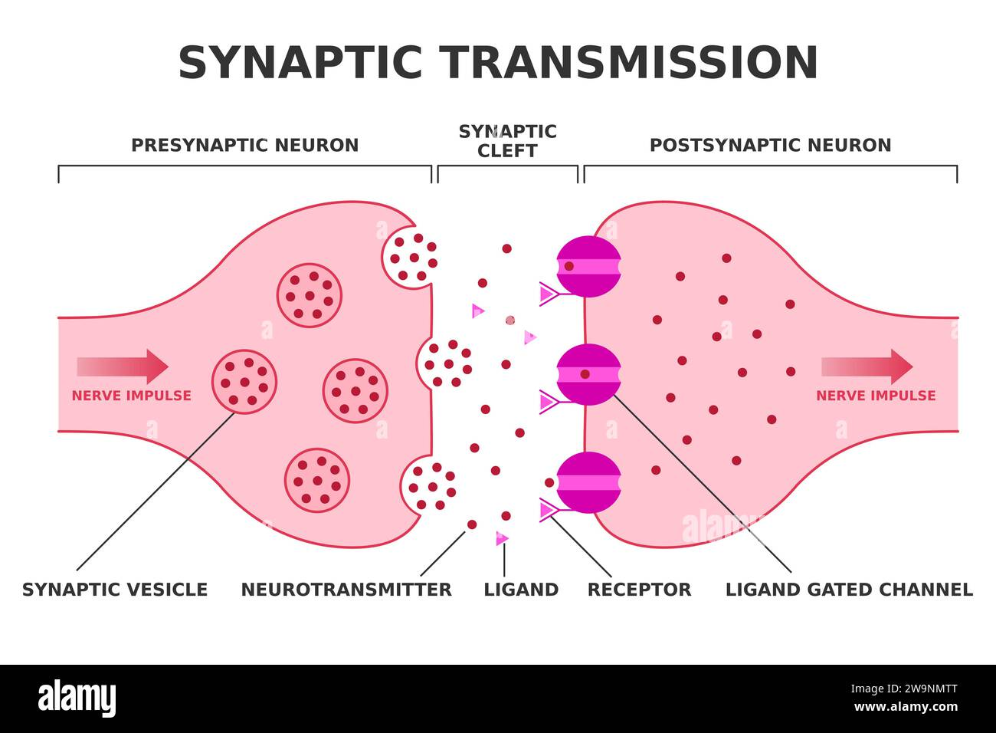

Slide 9
Please
Think of it like this;
Tolerance to cocaine
Less likely to feel pleasure
No reward
No motivation
Homeostasis will kick in, in the other direction but it takes time – how long?

Slide 10
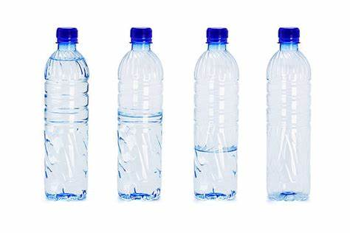
Cocaine Session
Lets Go
Demonstration
Not that type of demonstration
10 to 14 days
to replenish

Slide 11
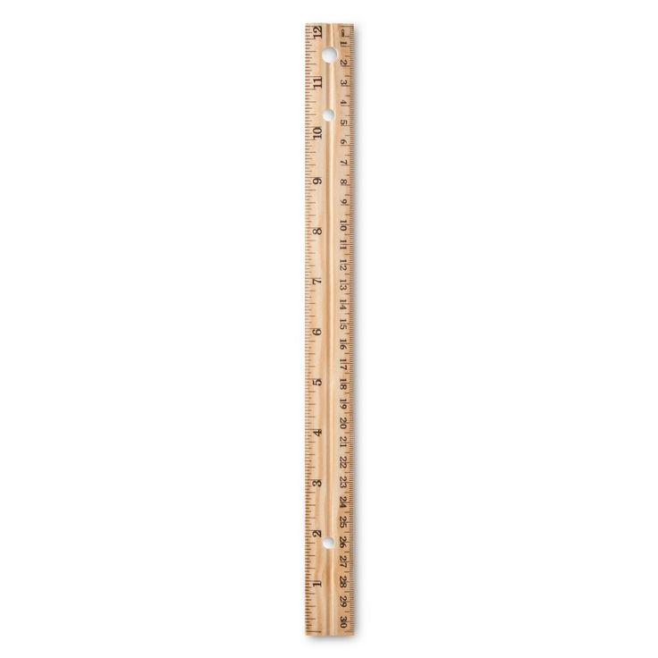
Brain chemical levels to function
Using to feel normal
It is a real thing

Slide 12
So how important is the brain
What is opioid withdrawal?
Liam in withdrawal
Or is he?

Slide 13
‘Beer Fear’
Lowered Inhibitions
Social Lubricate
Dutch Courage
Reduced Anxiety
As the effects of the alcohol wear off, your brain works to rebalance these chemicals by reducing GABA and increasing glutamate. This shift has the opposite effect of the night before, causing your brain to become more excitable and overstimulated, which can lead to feelings of anxiety.

Slide 14
NOTE TO SELF
If it has gone well promote other sessions
If it has not gone well, tell the story of when you got stabbed and get sympathy
Just kidding you have been a great group

Slide 15
Some other topics
Understanding Addiction
More Neuroscience
Substance Awareness
Blood Borne Viruses
Risk Factors
Stigma
Trends

Slide 16
Thank You for Listening
For further information
liam@bridgesprojects.org
Or I am sure the Healthwatch team will pass my details on

Slide 17
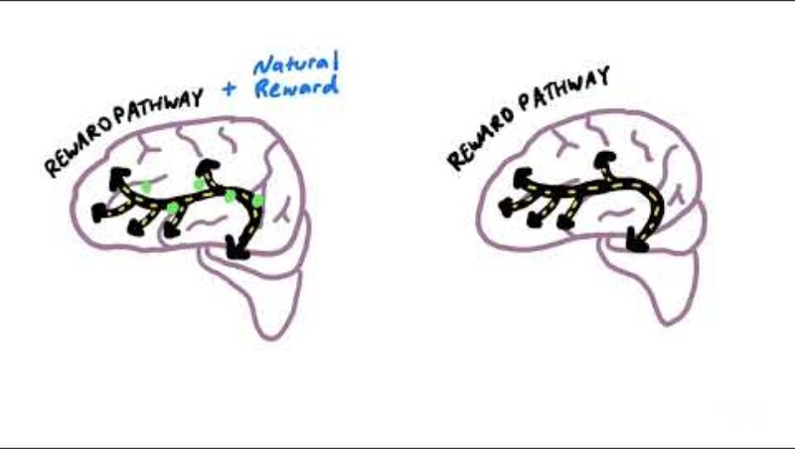

Slide 18
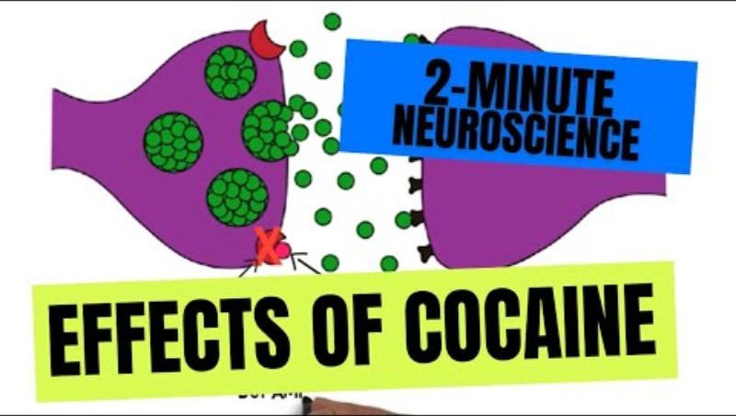

Slide 19
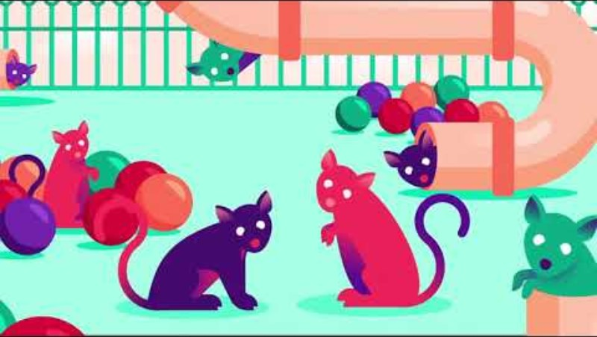
Rat Park

