Slide 1
Engaging Young People in Health Services.
"Empowering Youth”
Overcoming Challenges and Achieving Success. Susan Robinson and Angela Patrick
25/3/25

Slide 2
Overview
Importance of engaging young people in health services
Introduction
Welcome to our presentation on engaging young people in health services. Today, we will explore the successes and challenges faced in this endeavour and highlight the pivotal role of Healthwatch's Health & Care Ambassador Programme and the importance of the Stockton Public Health Resource Library in bridging the gap between health services and the community.
Importance of Engaging Young People in Health Services: Engaging young people in health services is crucial for several reasons. Young people are key stakeholders in the health system, and their active involvement leads to better health outcomes and more effective service design. By understanding their needs and preferences, we can create health services that are more accessible, relevant, and impactful.

Slide 3

STOCKTON PUBLIC HEALTH LIBRARY& HPAC SERVICES
SPHIL
The Public Health Information Library works alongside the public health team, supporting health professionals and community organisations with information, resources, books, and online information using the public libraries and its infrastructure as a delivery network.

Slide 4
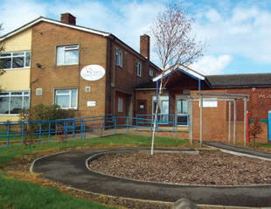
The Public Health Resource Library
Location
The Public Health Resource Library is available to anyone working to promote health and wellbeing across the Borough and is located:
Roseworth Family Hub,
Redhill Road,
Roseworth,
Stockton on Tees
TS19 9BX
The Health Library is open Monday to Friday 8.30am - 3.00pm
(closed for lunch from 1pm - 1.30pm)
Introductory visits to the health library are by appointment through, Angela Patrick-angela.patrick@stockton.gov.uk

Slide 5
How to access resources
Health Promotion Access Catalogue- HPAC
HPAC Stockton-on-Tees Usage Guide:
Accessing the System:
  Visit the HPAC Stockton-on-Tees website. www.sphil.nhs.uk
  Log in using your credentials if required.
  (You will need to sign up to HPAC to access the resources)

Slide 6
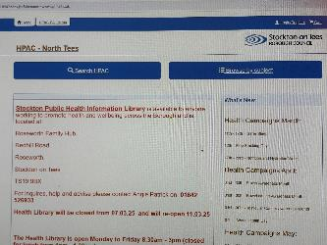
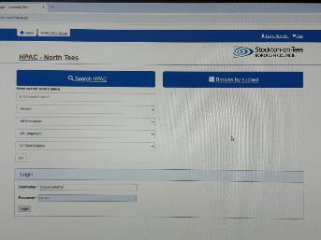
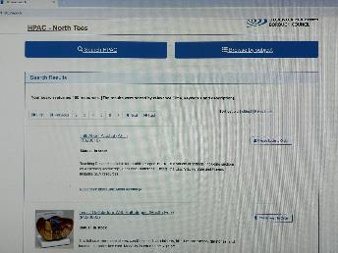
What does HPAC look like
What you should see

Slide 7
Step by Step
Navigating the system
Booking Resources:
Navigate to the 'Resources' section.
Browse through the available health promotion resources.
Select the items you need and add them to your booking list.
Confirm your booking and check for any specific instructions or collection detail

Slide 8
E.g. Ordering Leaflets:
  Go to the 'Leaflets' section.
  Choose the leaflets you want to order.
  Specify the quantity and any other relevant details.
  Submit your order and await confirmation. We can deliver to your nearest library or arrange for you to collect your items at a time that suits you.
This system is designed to streamline the process of accessing health promotion materials, making it easier for professionals and volunteers to support their communities effectively.

Slide 9
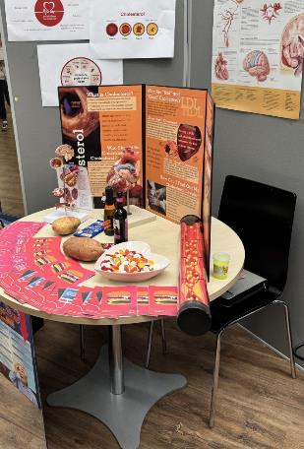
Our Health Library borrowers…
The Stockton Public Health Information Library is funded by our local Public Health team.
It is a FREE service for anyone working to promote health and wellbeing across the Borough.
Current borrowers include GP surgeries and Pharmacies, Family Hubs, the Livewell Dementia Hub, Workplace health champions & advocates and school nurses.

Slide 10

What can I find there?
A wealth of resources.
What does the library contain?
The library has books, DVDs, resource packs, leaflets, posters, models, displays and other materials available for loan.
Who can use the library?
Anyone working to promote health or studying health in Stockton. You can browse the library without registering for the service. To order and book materials you will need to register. Users of the library include NHS Primary Care and hospital staff, Stockton Borough Council staff, Connexions staff, teachers, students, community and voluntary organisations.

Slide 11
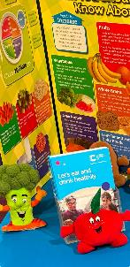

Borrowing suggestions
Vaping- Healthy Eating
The Goodness Gang Fruit and Vegetable Plush Toys add some healthy fun by using this resource to teach children about different fruit and vegetables, helps to promote a love for healthy eating.
The dangers of vaping magnetic pack is to be used with My Bodyboard this needs to be booked out separately.
The pack contains over 100 pictures and text magnets, it also comes with detailed, engaging activity plans. Perfect for Personal, Social and Economic (PSHE) education. Age 7- Adult

Slide 12
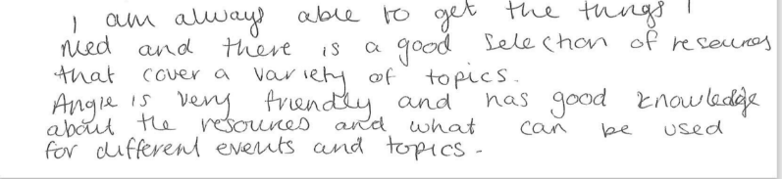
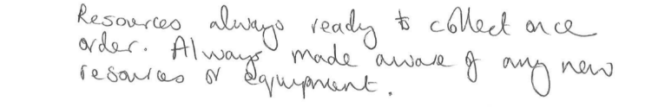
Our borrowers ‘nudge’ the health messages out into the community …

Slide 13
Importance of engaging young people in Stockton on Tees
Health Matters
Engaging young people in health and wellbeing initiatives in Stockton-on-Tees is crucial for several reasons:
Key Stakeholders: Young people are vital stakeholders in the health system. Their perspectives and experiences can significantly shape the design and delivery of health services, ensuring they are more relevant and effective
Improved Health Outcomes: Active involvement of young people leads to better health outcomes. When young people are engaged, they are more likely to adopt healthy behaviours and access health services, which can prevent long-term health issues

Slide 14
Building Trust: Engaging young people helps build trust between them and health service providers. This trust is essential for encouraging young people to seek help and participate in health programs
Community Empowerment: By involving young people in health initiatives, the community becomes more empowered. Young people can act as ambassadors, spreading health messages and encouraging their peers to take part in health-promoting activities
Tailored Services: Understanding the unique needs and preferences of young people allows for the creation of tailored health services that are more likely to be utilised and appreciated by this demographic
Long-term Benefits: Early engagement in health and wellbeing can set the foundation for lifelong healthy habits. This proactive approach can reduce future healthcare costs and improve overall community health
In Stockton-on-Tees, initiatives like the Health & Care Ambassador Programme play a crucial role in bridging the gap between health services and young people, ensuring that their voices are heard, and their needs are met.
.

Slide 15

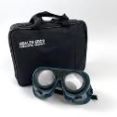

Success in engaging young people
Ideas
Create a Welcoming Environment:
  Design your space to be inviting and youth-friendly.
  Include quite spaces for private discussion, interactive displays, and include technology if you can.
Offer Youth-Centric Programs:
  Develop programs specifically for young people, such as health workshops, wellness groups, and peer-led discussions.
  Use engaging formats like games, quizzes, and interactive activities to make learning fun.

Slide 16
Digital Resources:
  Promote digital health resources available in the libraries, such as e-books, online databases, and health apps.
  Encourage young people to explore these resources through guided sessions.
  (We can provide this)
Collaborate with Schools and Community Groups:
  We partner with local schools, youth clubs, and community organisations to promote library resources.
  We organise joint events and outreach programs to reach a wider audience.

Slide 17
Peer Involvement:
  Involve young people in the planning and execution of health programs.
  Create youth ambassador roles to help promote library resources and engage their peers. E.g. The Healthwatch youth ambassador program.
Workshops and Events:
  As a health library we support workshops and displays on topics relevant to young people, such as mental health, nutrition, and physical activity. We currently support schools, colleges and home educated families with age-appropriate activities.
  We use hands-on activities and real-life scenarios to make the sessions more relatable.
Feedback and Adaptation:
  We regularly seek feedback from young people on the resources and programs offered.
  We adapt and improve based on their suggestions to ensure the library meets their needs.
By implementing these strategies, libraries and health professional spaces can become valuable hubs for young people to learn about and engage with health and wellbeing resources

Slide 18
Success
Stockton Sixth Form College, volunteer event
On Tuesday, 11th February, Stockton Sixth Form College, hosted a fantastic, volunteering and health services event. This inspiring two-hour event brought together students, local organisations, and health professionals, creating a vibrant atmosphere of engagement and opportunity. They kindly invited the public health library to attend, we offered guidance on how students can play a more active part in health and wellbeing initiatives and make a real difference in their local communities. The event provided students with valuable insights into volunteering opportunities and health and wellbeing services available to them and their families. The enthusiasm and curiosity displayed by the students was amazing! It was wonderful to see so many young people eager to engage and contribute to the local community whilst gaining valuable skills and experience for their future careers. We successfully engaged with 59 students on the day. With a host of fun activities and a firm focus on the students' own interests and ideas. This event is one of many we attend and goes to highlight the power of collaboration between education and community organisations, fostering a spirit of service and awareness among the next generation of professionals.

Slide 19
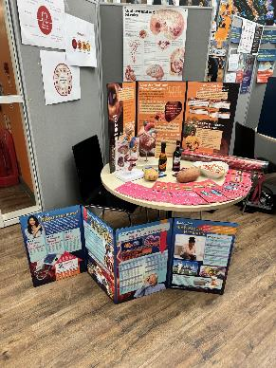
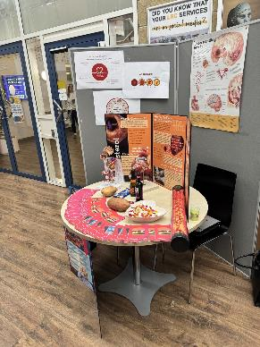
More brilliant work in collaboration with Stockton Riverside College
Health displays
S.W ,a student at Stockton Riverside College, used some of the resources from the Health Library as part of the Fast Track Higher Education Health Course.

Slide 20
Common Challenges
Trust and Communication Barriers:
  Building trust with young people can be difficult, especially if they have had negative experiences with health services in the past
  Effective communication is crucial, but young people may feel hesitant to share their views and needs openly especially in front of their peers or in busy environments.
  Diverse Needs and Preferences:
Young people have varied needs and preferences, making it challenging to design programs that cater to everyone. Ensuring inclusivity and relevance requires continuous adaptation and feedback.

Slide 21
Engagement and Participation:
  Motivating young people to participate in health initiatives can be challenging due to competing interests and busy schedules
.
  Providing appropriate incentives and creating engaging activities are essential to maintain their interest
.
Navigating Community Dynamics:
  Understanding and addressing the unique dynamics of different.
  Tailoring approaches to fit specific community contexts can be complex and resource-intensive
.

Slide 22
Sustainability:
  Ensuring the long-term sustainability of youth engagement programs requires ongoing support and resources
  Securing funding and maintaining enthusiasm among participants is critical for continued success
By acknowledging and addressing these challenges, we can better engage young people and make a meaningful impact on their health and wellbeing.

Slide 23
Conclusion
Call to action
Summary: Engaging young people in health services is crucial for improving health outcomes and designing effective programs. While there have been notable successes, such as increased participation and tailored services, challenges like funding issues and diverse needs persist. Together with the Healthwatch Ambassador Programme, we can all play a vital role in bridging the gap between young people and health services, fostering better communication and inclusion.
Call to Action: We must continue our efforts to engage young people, recognising their importance as key stakeholders. Community involvement is essential for creating sustainable and impactful health initiatives. Let's work together to empower the next generation and ensure their voices are heard in shaping health services by supporting Healthwatch and promoting the Public Health Resource Library to all our valued health and wellbeing service providers and young people across Stockton on Tees.

Slide 24

Any Questions
Please get in touch
Thank you for listening.
Susan.robinson@stockton.gov.uk
Angela.patrick@stockton.gov.uk
01642 526933
Why not book a visit, we have an open day taking place on Monday April 7th 10am-2pm, we will be happy to show you around. If you cannot make that date, just give us a call and we will do our best to work around your schedule.

