Slide 1


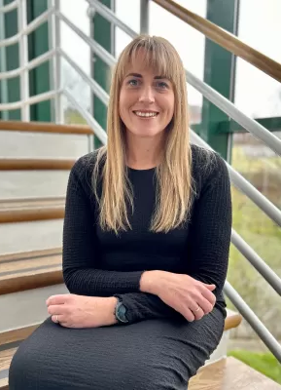
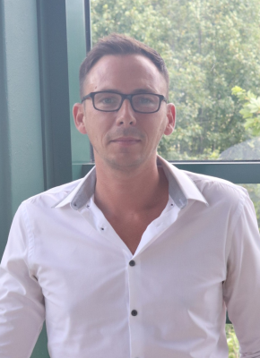
Lindsay Graham: Lancashire & South Cumbria Director
People First
Advocacy Support

Slide 2


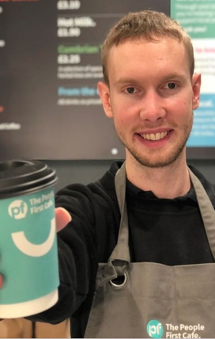
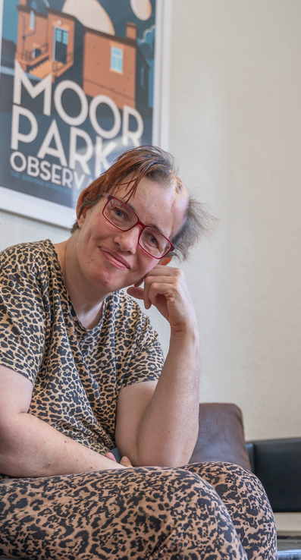
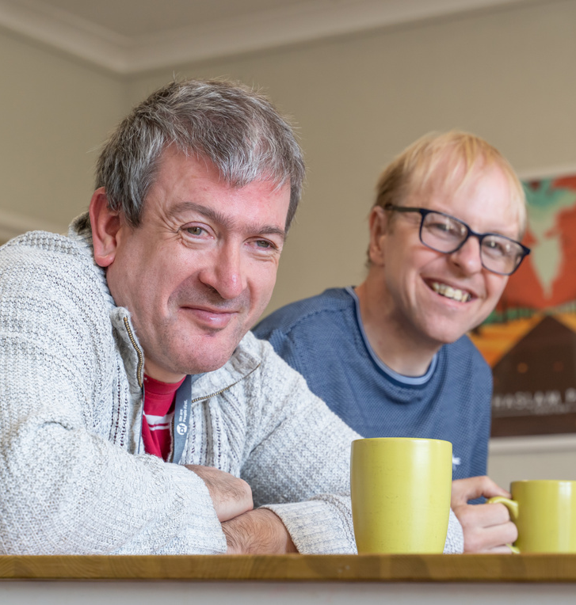
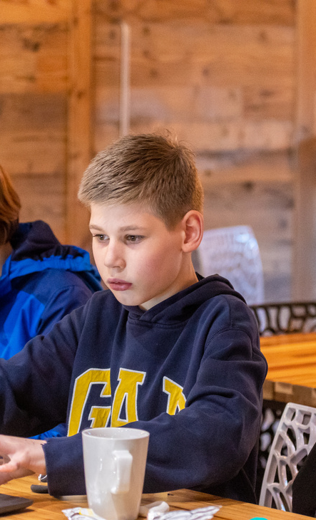
Tees Independent Advocacy Hub
Stockton-on-Tees

Slide 3


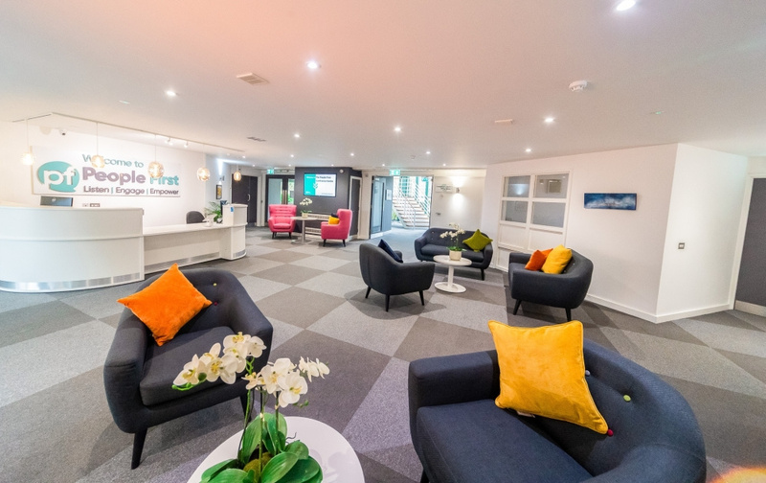


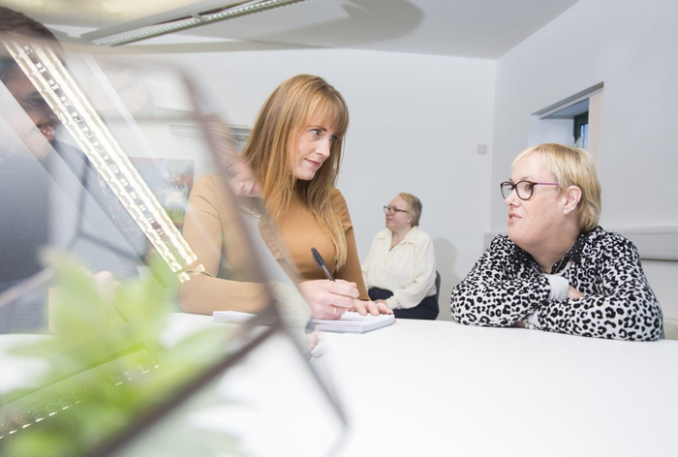
What is Independent
Advocacy?
Supporting people to:
Speak up for themselves
Uphold their rights and choices
Navigate processes
Access information and services that can support them
Tell people what is important to them

Slide 4


Our Offer
Care Act Advocacy
Independent Mental Health Advocacy
Independent General Advocacy
Independent Mental Capacity Advocacy
Supporting people through needs assessments, care reviews and safeguarding
Supporting people who have been assessed as lacking capacity to make specific decisions
Supporting people who have been sectioned under the Mental Health Act
Supporting people with a health or social care need on general issues

Slide 5
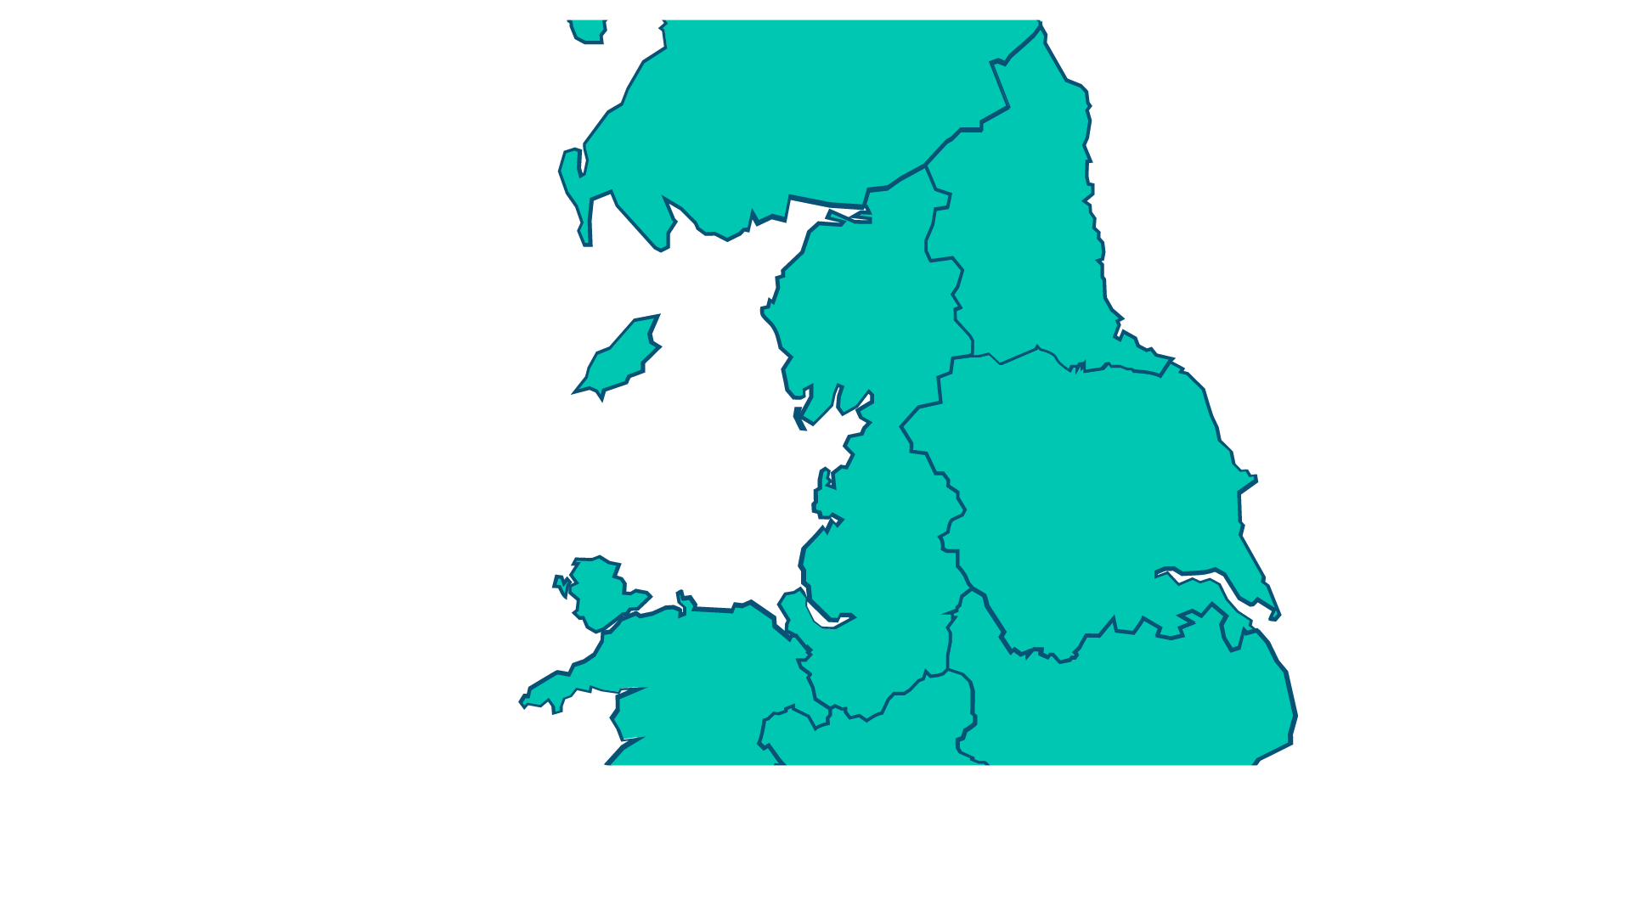
Where we work
  Stockton-on-Tees
  Hartlepool
  Middlesbrough
  North Yorkshire
  Redcar and Cleveland

Slide 6

How to get in touch?
www.wearepeoplefirst.co.uk
0300 3038 037
Healthwatch Stockton-on-Tees

